Slide 1
Student Organization Training
Office of Student Life | Fall 2025

Slide 2
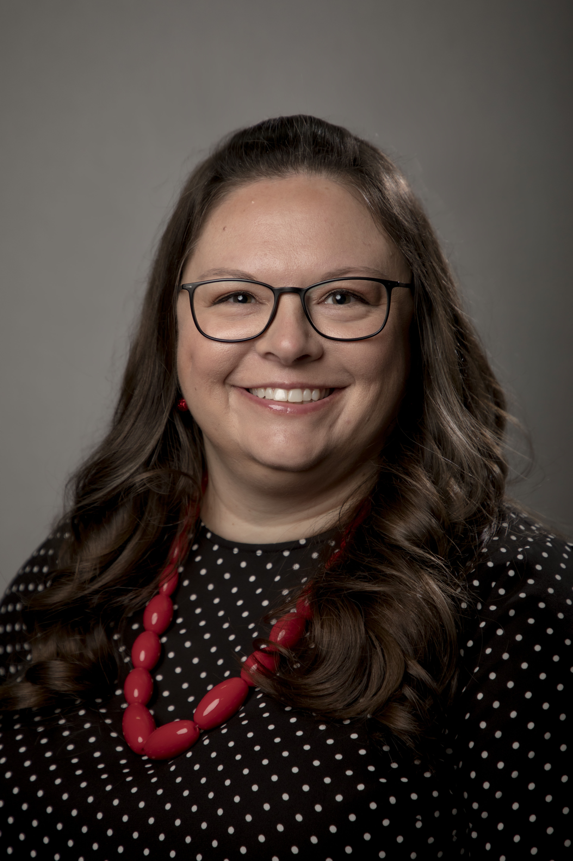
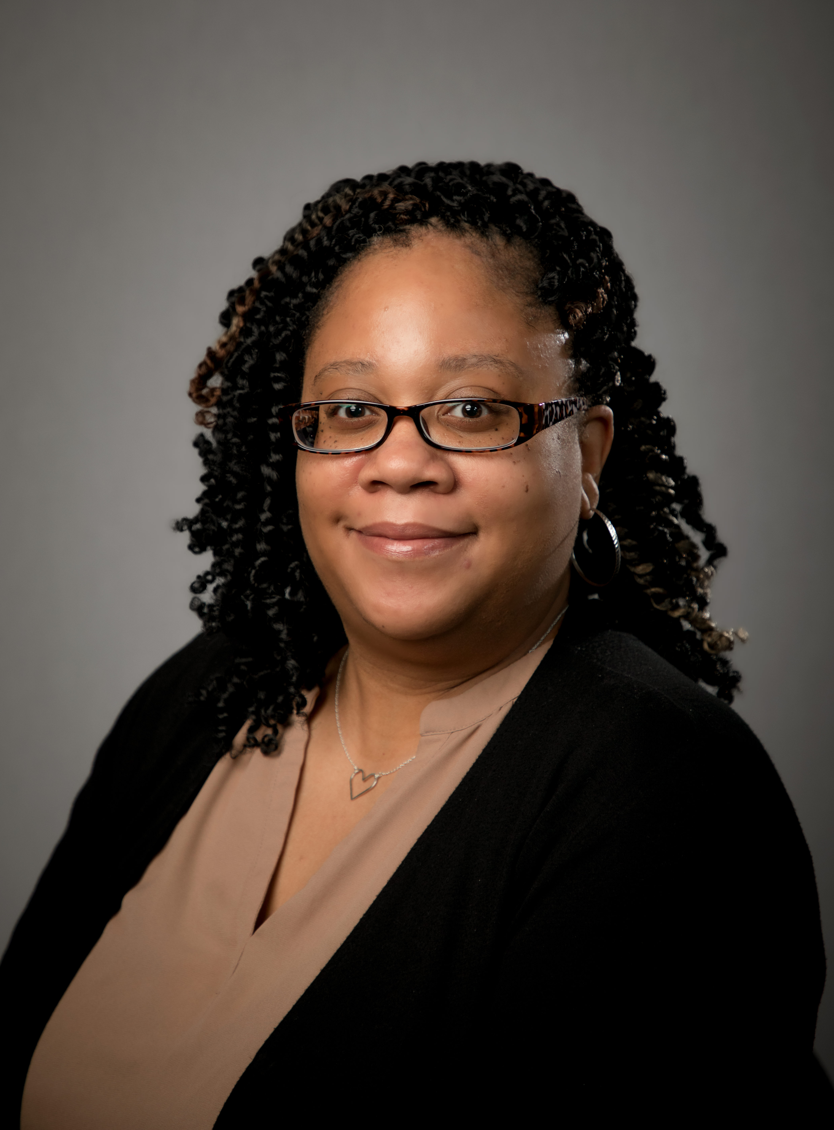
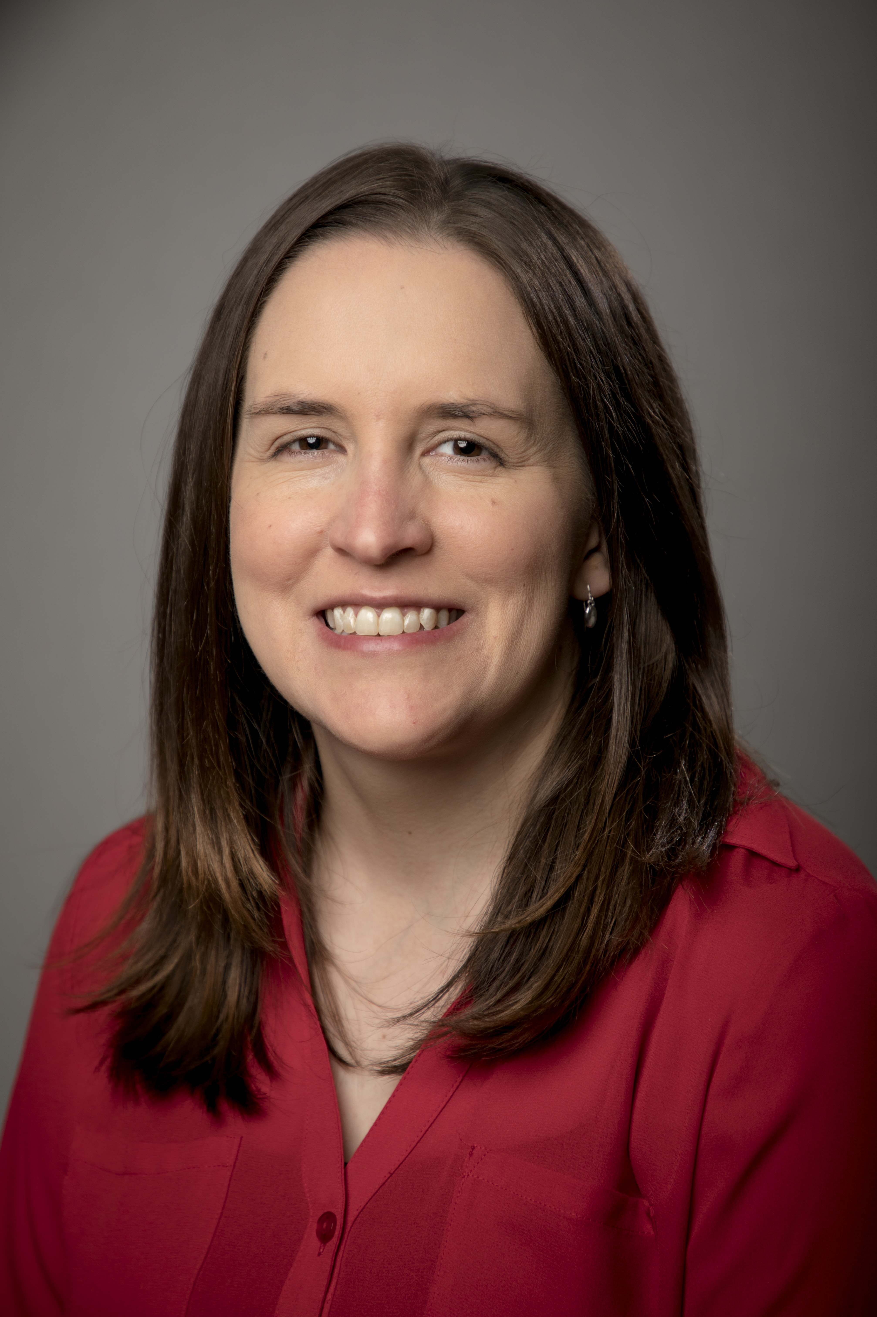


Student Life Overview & Introductions
Office Overview
Staff

Slide 3
Office Contact Information
Email: Student.Life@ttuhsc.edu
Phone: 806-743-2302
Website: www.ttuhsc.edu/student-life
Location: Lubbock Campus, 2C400 – HSC Student Affairs Suite

Slide 4
Hazing Prevention
Website: https://www.ttuhsc.edu/student-affairs/hazing.aspx
  Stop Campus Hazing Act
  Policy information
    TTU System Regulation 07.19
    HSC OP 52.20
  Reporting Form
Resources

Slide 5
Institutional SGA
Represents all schools and campuses
Amarillo & Abilene have campus specific Senate/SGA

Slide 6
2025-2026 Funding Rules & Regulations
Funding Regulations Handbook
  Senate Funding Cannot Pay For
    Fundraising Purchases
    Events When Charging for Entry
    Donations
  Food Expenditures
    Vendor MUST take MasterCard payment over the phone

Slide 7
2025-2026 Funding Rules & Regulations
Travel
  Organization Related/Sponsored
  Less than 10 – Reimbursement Process
  Travel Process Documents
  Conference Registration – can be paid ahead
  Hotel Payment Policy
  Students pay their own expenses

Slide 8
2025-2026 Funding Rules & Regulations
Guidelines:
  President & Treasurer Must Attend Fall & Spring Trainings
    Fall Student Org Training (5% deduction)
    Spring Student Org Training (5% deduction)
  Signed Funding Contract due by September 30th (1% deduction)
  Purchase Requests submitted by 2-week prior deadline (3% deduction each instance)
  Deductions will be to the 2025-2026 Allocation

Slide 9
SGA Special Projects Fund
Funds student organizations that are brand new or that have run out of funds.
For a one-time or unforeseen need
Form can be located in HSC Net under the Forms tab – SGA Special Projects Fund Request
Only available while SGA is in session to review (late September – early April)
Medicine organizations wanting to request for travel funding must first request from the Dean’s Contingency Fund (through MSG & SOM Dean’s Office)

Slide 10
Promotional Item Purchase Process
Approved Vendors
  TTUHSC Printing Center
  Advanced Graphix
  Brand Ability
Design must be approved by Marketing
Payment is completed through a Purchase Order (check or direct deposit)

Slide 11
Coca-Cola Campus
TTUHSC is in contract with Coca-Cola, only products by their company can be purchased.
This includes water and sports drinks.
  Water – Dasani, Smartwater, Vitamin Water, and Topo Chico
  Sports Drinks – Powerade
  Lemonade – Minute Maid or Simply
  Tea – FUZE, Gold Peak or Honest Tea
  Energy Drinks – Monster, Full Throttle, NOS

Slide 12
Reminder on Purchases
Our office must handle ALL purchases on your Senate account
DO NOT make a purchase yourself
Personal Reimbursements are Not Allowed
If purchase is using on-campus Agency Funds (SOM groups), please use the Spending Request Form – Medicine Organization Agency Funds Only in HSC Net

Slide 13
Senate Spending Requests
Purchase Request System in HSC Net
Must submit at least 2 weeks prior to event/meeting
  If for a large event or travel, please submit at least 30 days prior.
Our office will contact you with any questions for any further information we need

Slide 14
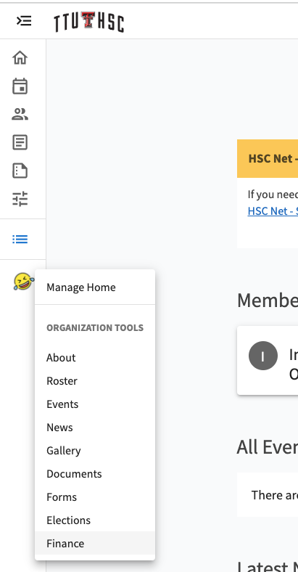
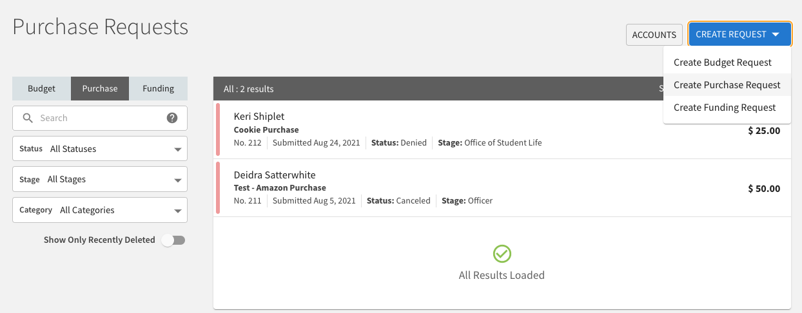
Purchase Request Process
Go to the Finance Tab
Click “Create Request”
  Select “Create Purchase Request”

Slide 15
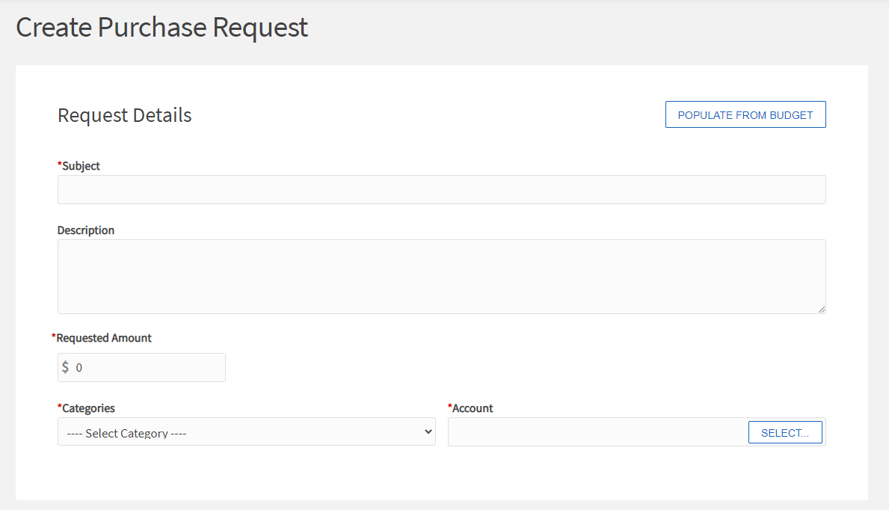
Purchase Request Process
Enter Request Information
Select your Senate Account
  If a Multi-Campus org, please select the correct Campus’ Senate Account

Slide 16
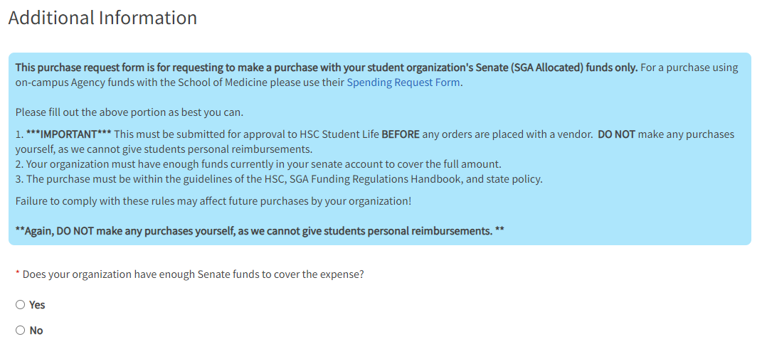
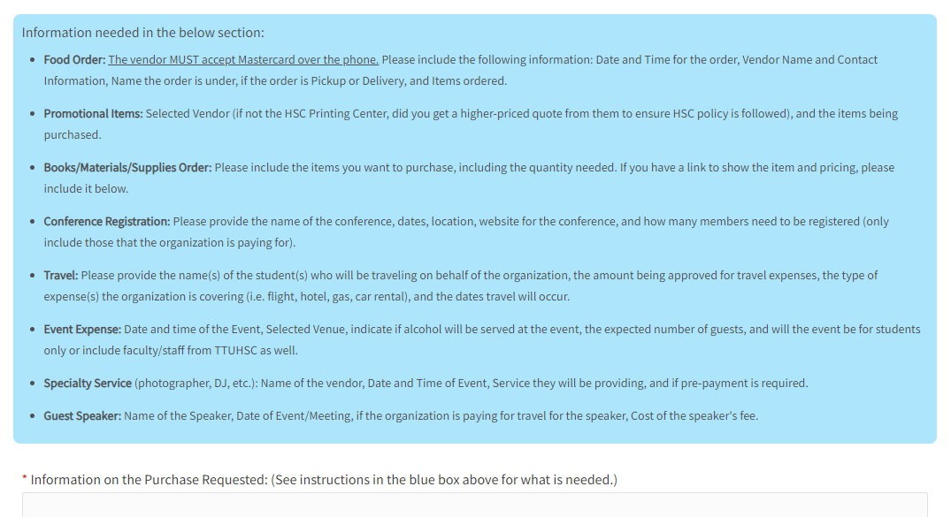
Purchase Request Process
Additional Information section
  Follow instructions for the type of purchase you are requesting.
  Required File Upload
    RSVP List
Once finished, click “Submit Request”

Slide 17
HSC Net - ttuhsc.campuslabs.com/engage/
Roster
  Privacy Settings
Events
Finance
Elections

Slide 18
Funding Contract
Sign and Email to Student Life (student.life@ttuhsc.edu)
  President, Treasurer and Advisor
Must be returned to Student Life by September 30th
Once submitted, Senate spending may begin.

Slide 19
Key Reminders
SGA Regulations for Training and Deadlines
2-Week Deadline for Purchase Requests
Items purchased with Senate funds cannot be sold or donated externally
Travel Forms
Officer Transition
Rosters

Slide 20
Reminders
Use of TTUHSC name/logo
Contacting Media

Slide 21
Important Dates
February 20, 2026 – Deadline
  2026-2027 SGA Budget Request Form
  Re-Registration
June 5, 2026 – Deadline
  Major Senate Expenditures
August 3, 2026 – Purchase Request Deadline
  Final 2025-2026 Year Senate Expenditures

Slide 22
Questions?

