Slide 1


Associations between Diabetes, Cognitive Status, and Hispanic Ethnicity amongst Older Rural West Texans: A Project FRONTIER Study
Riley McCready^{1,2}, Claudia Morris^{1,2}, and J. Josh Lawrence^{1,2,3,4,5}
¹Department of Pharmacology and Neuroscience, ²School of Medicine, ³Garrison Institute on Aging, ⁴Center of Excellence for Translational Neuroscience and Therapeutics, ⁵Center of Excellence for Integrated Health, Texas Tech University Health Sciences Center, Lubbock, TX, USA
2nd ANNUAL
WEST TEXAS HEALTH DISPARITIES
RESEARCH SYMPOSIUM

Slide 2
Disclosure
2nd ANNUAL
WEST TEXAS HEALTH DISPARITIES
RESEARCH SYMPOSIUM
Nothing to Disclose

Slide 3
Introduction
2nd ANNUAL
WEST TEXAS HEALTH DISPARITIES
RESEARCH SYMPOSIUM
Diabetes is associated with cognitive decline^{1,2}, and previous studies suggest that Hispanic populations have a higher risk of diabetes and cognitive decline³⁻⁵.
Project FRONTIER (PF; Facing Rural Obstacles to Health Care Now Through Intervention, Education, and Research) is an ongoing longitudinal study following West rural Texans’ medical history.
We conducted a retrospective case-control study following 292 individuals from Project FRONTIER to investigate the relationships between a variety of variables (mean age 62.6 ±11.8, 70.5% females, 40.1% HE).
Variable | PF Code
Repeatable Battery for the Assessment of Neuropsychological Status (RBANS) total score | rbttlsc
Fasting blood glucose level | bw_gluc
HbA1c level | bw_hgba1
Consensus diabetes diagnosis (consensus diagnosis = 1, no consensus diagnosis = 0) | cdx_mdca
Hispanic Ethnicity (HE) status (HE = 1, non-HE = 0) | ds_16_3-JL

Slide 4
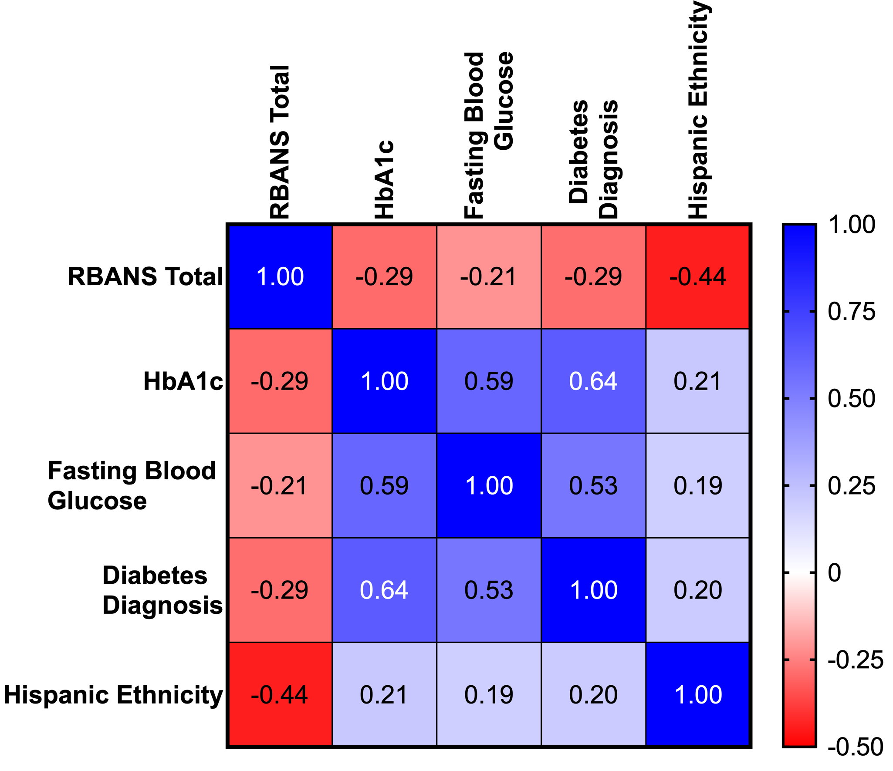
RBANS vs. All Variables
2nd ANNUAL
WEST TEXAS HEALTH DISPARITIES
RESEARCH SYMPOSIUM
RBANS showed significant negative correlations with:
  HbA1c (p < 0.0001)
  Fasting blood glucose (p = 0.00024)
  Consensus diabetes diagnosis (p < 0.0001)
  HE status (p < 0.0001)
HE status showed significant positive correlations with:
  HbA1c (p = 0.00025)
  Fasting blood glucose (p = 0.00105)
  Consensus diabetes diagnosis (p = 0.00051)

Slide 5
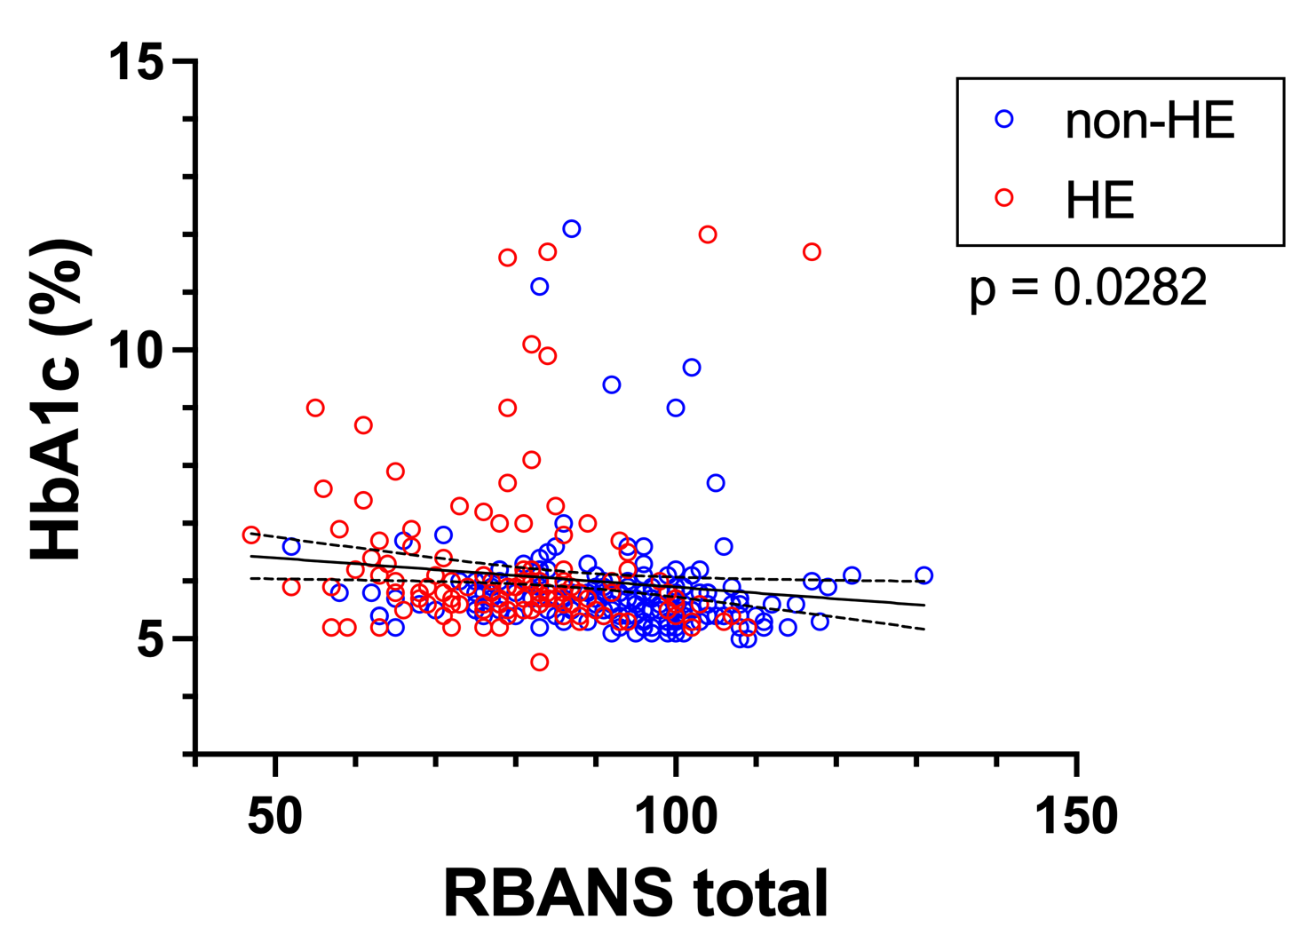
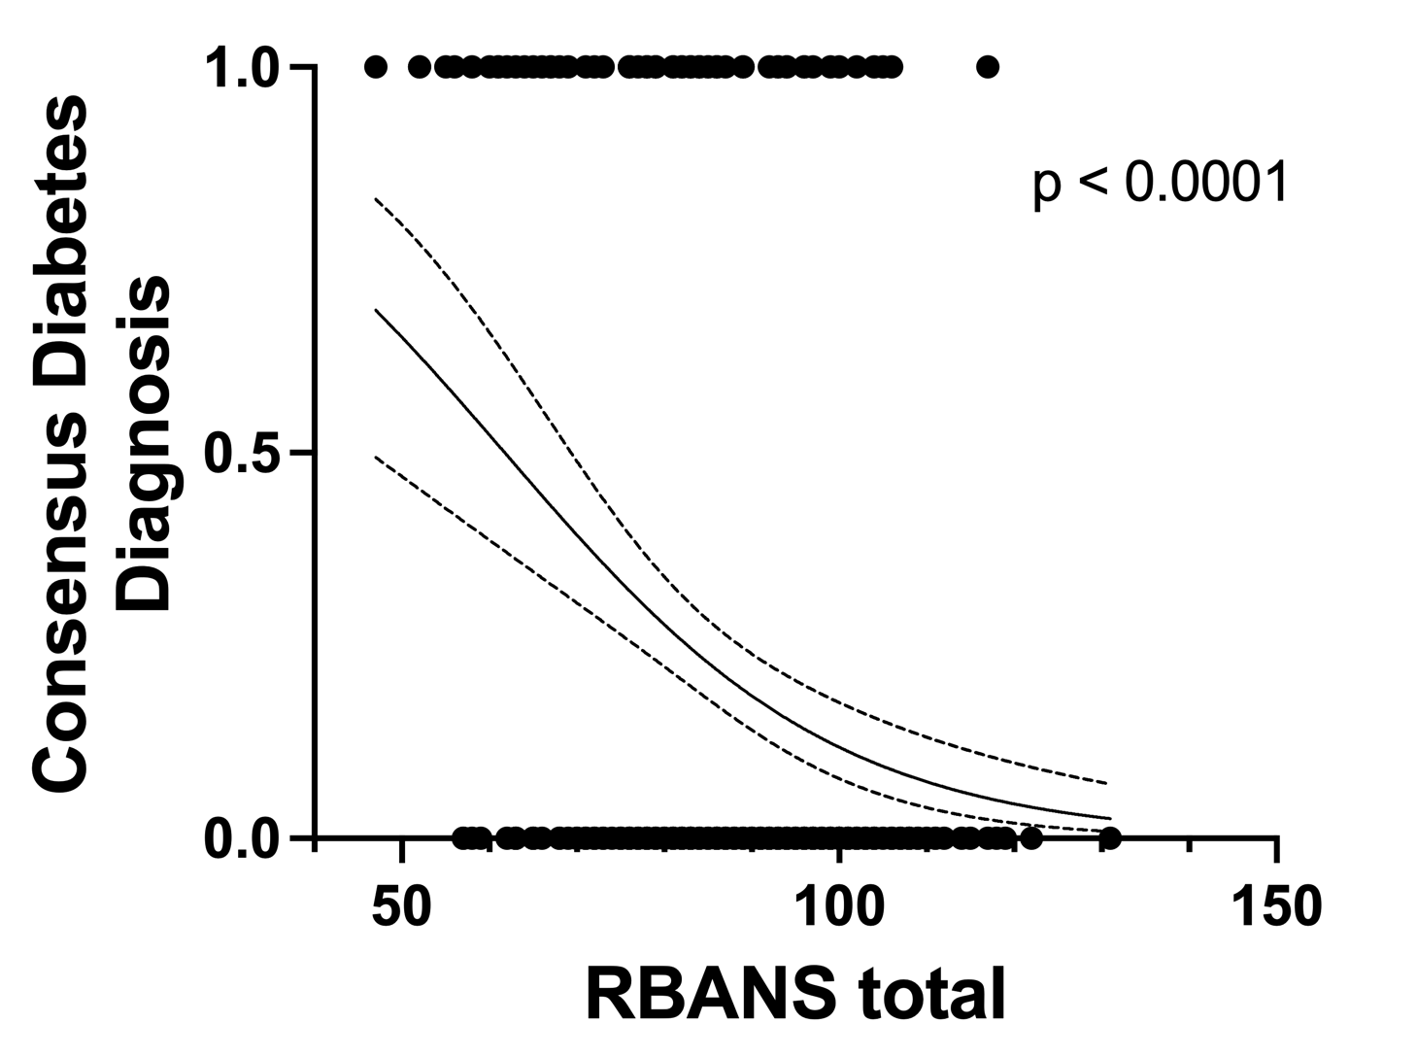
RBANS vs. Diabetic Indicators
2nd ANNUAL
WEST TEXAS HEALTH DISPARITIES
RESEARCH SYMPOSIUM
Simple linear regression of the relationship between RBANS total score and HbA1c level showed significant negative association (p = 0.0282). Dotted lines indicate 95% confidence intervals.
Simple logistic regression of the relationship between RBANS total score and consensus diabetes diagnosis showed significant negative association (p < 0.0001). Dotted lines indicate 95% confidence intervals.

Slide 6
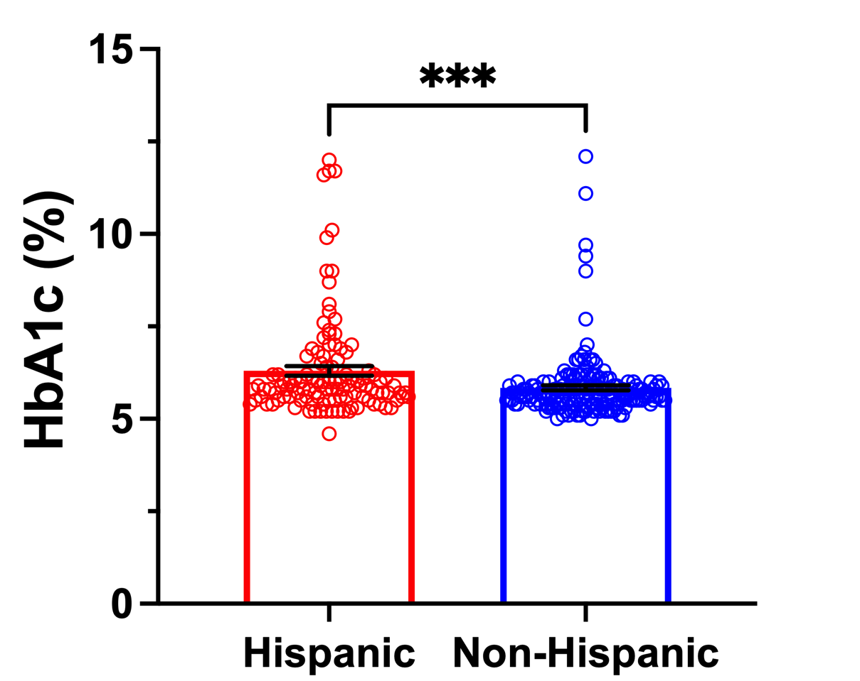
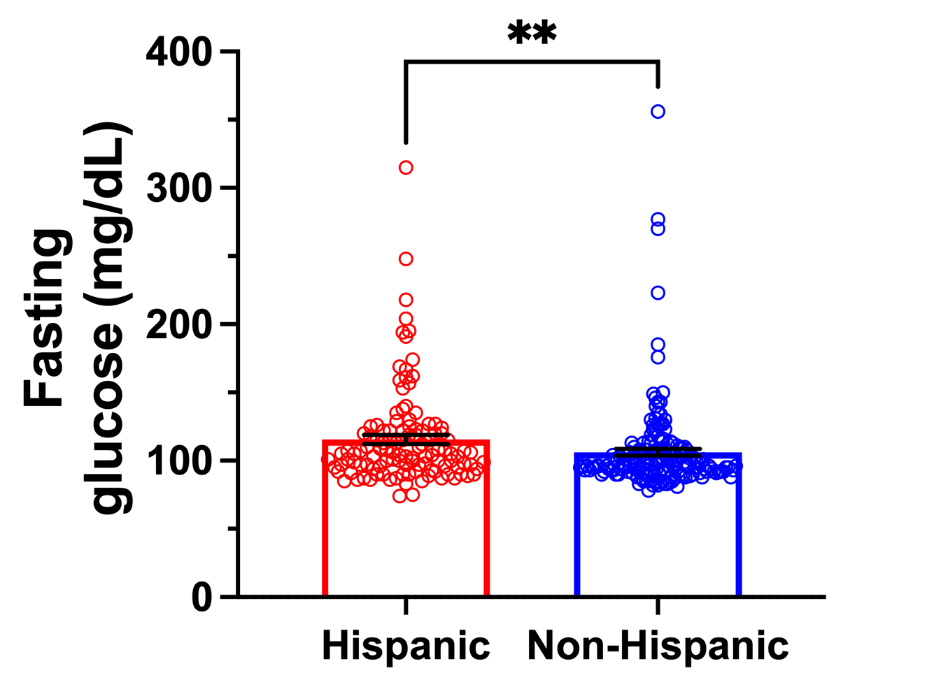
Diabetic Indicators vs. HE
2nd ANNUAL
WEST TEXAS HEALTH DISPARITIES
RESEARCH SYMPOSIUM
Mann-Whitney nonparametric test indicated that HbA1c levels were significantly higher in Hispanic (6.3 ± 1.4%) compared to non-Hispanic (5.8 ± 0.9%) participants (p = 0.0003).
Mann-Whitney nonparametric test indicated that fasting blood glucose levels were significantly higher in Hispanic (115.5 ± 35.5 mg/dL) compared to non-Hispanic (106.2 ± 32.3 mg/dL) participants (p = 0.0011).

Slide 7
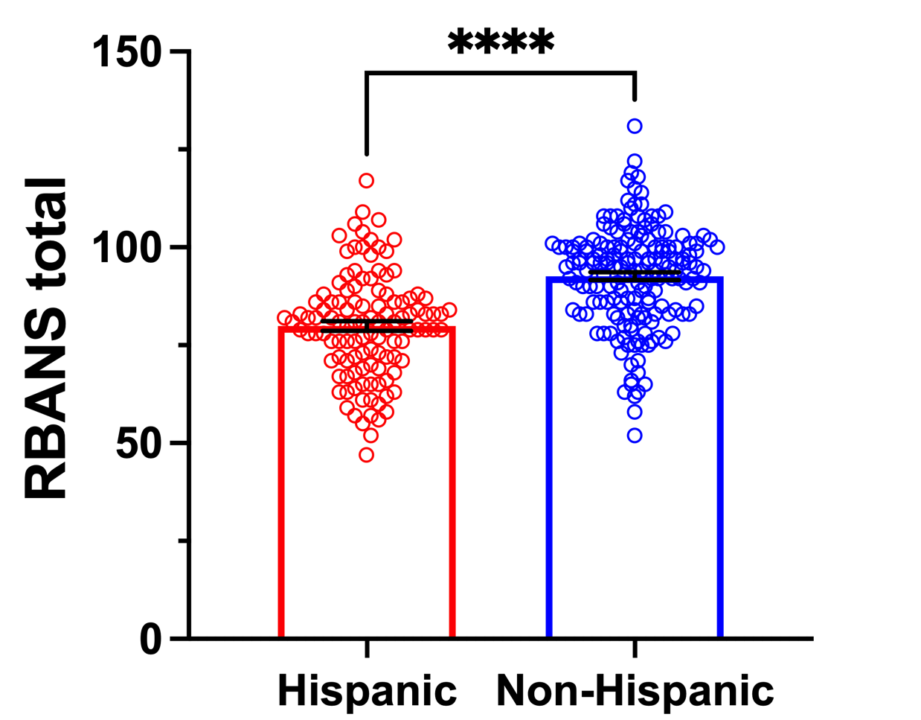
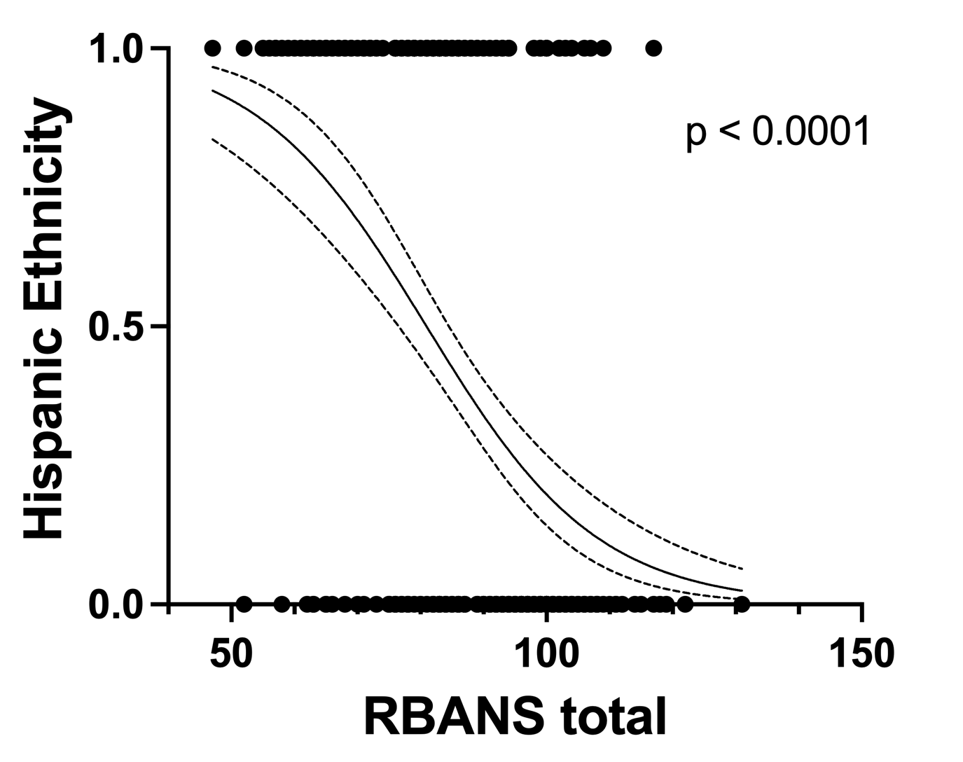
RBANS vs. HE
2nd ANNUAL
WEST TEXAS HEALTH DISPARITIES
RESEARCH SYMPOSIUM
Mann-Whitney nonparametric test indicated that RBANS total scores were significantly lower in Hispanic (80.0 ± 13.3) compared to non-Hispanic (92.7 ± 12.9) participants (p < 0.0001).
Simple logistic regression of the relationship between RBANS total score and HE status showed significant negative association (p < 0.0001). Dotted lines indicate 95% confidence intervals.

Slide 8
2nd ANNUAL
WEST TEXAS HEALTH DISPARITIES
RESEARCH SYMPOSIUM
Conclusions/Future Directions
We found significant negative correlations between RBANS and HbA1c, fasting blood glucose, consensus diabetes diagnosis, and HE status.
We identified significant positive correlations between HE status and HbA1c, fasting blood glucose, and consensus diabetes diagnosis.
Further linear regression analysis revealed significant negative associations between RBANS and HbA1c, consensus diabetes diagnosis, and HE status.
Group comparisons revealed HE was associated with higher levels of diabetic indicators and greater levels of cognitive decline.
These disparities are important to consider when investigating areas to improve healthcare in West Texas. For future projects, we plan to further characterize the relationship between cognitive decline and diabetes through exploring various RBANS subtests/domains including attention, language, visuospatial/constructional abilities, immediate memory, and delayed memory.

Slide 9


Acknowledgements/References
2nd ANNUAL
WEST TEXAS HEALTH DISPARITIES
RESEARCH SYMPOSIUM
We would like to thank the Garrison Institute on Aging (GIA) staff for providing the variables. Special thanks to Dr. Volker Neugebauer (GIA) and Veronica Molinar-Lopez (Project FRONTIER).
Dyer, A. H., Briggs, R., Laird, E., Hoey, L., Hughes, C. F., McNulty, H., Ward, M., Strain, J., Molloy, A. M., Cunningham, C., & McCarroll, K. (2021). Glycated haemoglobin (HbA1c), diabetes and neuropsychological performance in community-dwelling older adults. Diabetic Medicine, 38(11), e14668. https://doi.org/10.1111/dme.14668
Zheng, F., Yan, L., Yang, Z., Zhong, B., & Xie, W. (2018). HbA1c, diabetes and cognitive decline: The English Longitudinal Study of Ageing. Diabetologia, 61(4), 839–848. https://doi.org/10.1007/s00125-017-4541-7
Aguayo-Mazzucato, C., Diaque, P., Hernandez, S., Rosas, S., Kostic, A., & Caballero, A. E. (2019). Understanding the growing epidemic of type 2 diabetes in the Hispanic population living in the United States. Diabetes/Metabolism Research and Reviews, 35(2), e3097. https://doi.org/10.1002/dmrr.3097
Hall, J. R., Balldin, V. H., Gamboa, A., Edwards, M. L., Johnson, L. A., & O’Bryant, S. E. (2018). Texas Mexican American Adult Normative Studies: Normative data for the Repeatable Battery for the Assessment of Neuropsychological Status (RBANS). Developmental Neuropsychology, 43(1), 27–35. https://doi.org/10.1080/87565641.2017.1401629
5. Johnson, L. A., Gamboa, A., Vintimilla, R., Cheatwood, A. J., Grant, A., Trivedi, A., Edwards, M., Hall, J. R., & O’Bryant, S. E. (2015). Comorbid depression and diabetes as a risk for mild cognitive impairment and Alzheimer’s disease in elderly Mexican Americans. Journal of Alzheimer’s Disease, 47(1), 129–136. https://doi.org/10.3233/JAD-142907

