Slide 1


Diversity and Inclusivity in Clinical Practice increases confidence, competence, and clinical skills for pre-clinical medical students
Nedha Kinnare, B.A;¹ Jessica Ramirez, B.S; ¹ Emme Baysden, B.A, MPH; ¹Rachel Vopni, B.A.; ¹ Rachel Johnson, B.S. ¹
1. Texas Tech University Health Sciences Center, School of Medicine
2nd ANNUAL
WEST TEXAS HEALTH DISPARITIES
RESEARCH SYMPOSIUM

Slide 2
2nd ANNUAL
WEST TEXAS HEALTH DISPARITIES
RESEARCH SYMPOSIUM
DISCLOSURES
No disclosures to note

Slide 3
2nd ANNUAL
WEST TEXAS HEALTH DISPARITIES
RESEARCH SYMPOSIUM
Background
Clinical skills are an essential component in the holistic care of a patient
Medical school curriculums may lack emphasis on incorporation of clinical skill education for marginalized communities
There is minimal research that examines medical student confidence, competence, and perceived clinical skills in working with these underserved populations
A student-run elective was created to provide enhanced didactic and hands-on diversity training to interested first- and second-year medical students
Students participated in health disparity and clinical education lectures then applied what they learned through Standardized Patient (SP) encounters

Slide 4
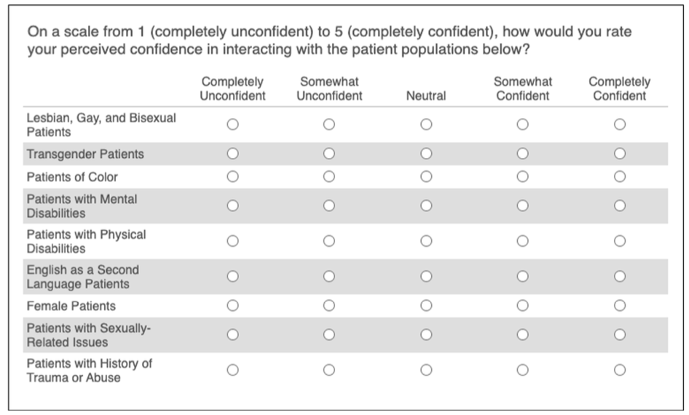
2nd ANNUAL
WEST TEXAS HEALTH DISPARITIES
RESEARCH SYMPOSIUM
Methods
A pre- and post-test Likert-style survey was administered to assess perceived clinical confidence, competence, and skill working with marginalized communities discussed in the elective
These included individuals who identified with a group from the following:
  Lesbian, gay, and bisexual
  Transgender
  Black, indigenous, people of color
  Mental disabilities those with physical disabilities
  English as Second Language
  Female
  Sexually related issues
  History of trauma/abuse
Twenty students completed the survey at entry and exit time points
Results were de-identified for data analysis

Slide 5
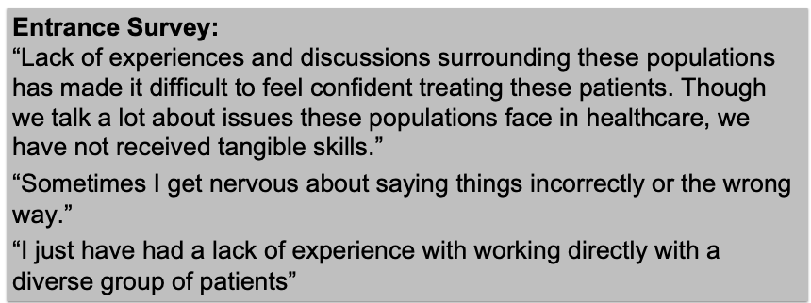
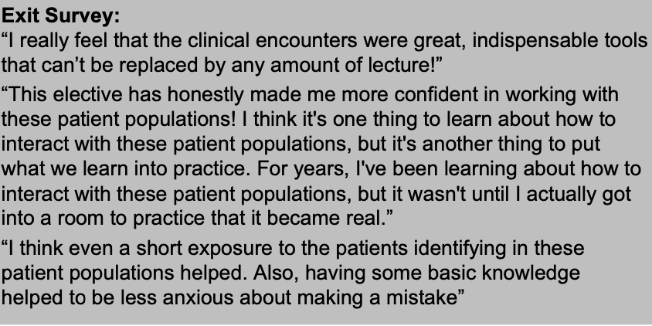
2nd ANNUAL
WEST TEXAS HEALTH DISPARITIES
RESEARCH SYMPOSIUM
Results
 | Before the Course | After the Course
Confidence | 3.78 | 4.33
Competence | 3.38 | 4.02
Perceived Clinical Skills | 3.2 | 3.88
(1- “completely unconfident” to 5- “completely confident”)
Overall, the elective course increased the confidence, competence, and perceived clinical skills in student interactions with underserved communities.

Slide 6
Conclusion
2nd ANNUAL
WEST TEXAS HEALTH DISPARITIES
RESEARCH SYMPOSIUM
The practice encounters in the elective sought to better equip pre-clinical medical students in their interactions with marginalized patient populations
Increasing pre-clinical students’ confidence, competence, and perceived clinical skills with marginalized communities moves towards mitigating disparities in West Texas and beyond
Future Directions:
Spread the word and encourage more schools to adopt similar practice initiatives
Follow up with students to see if the elective made a difference in their clinical education curriculum
Increase the number of practice scenarios and cases

Slide 7
*PLEASE DELETE THIS SLIDE BEFORE PRESENTATION
EARLY DAWN
HEX: #FFF4DE
RGB: 255/244/222
TOMATO
HEX: #F46946
RGB: 244/105/70
WHITE
HEX: #FFFFFF
RGB: 255/255/255
GOLDEN TAINOI
HEX: #FFBD59
RGB: 255/189/89
DARK RED
HEX: #990000
RGB: 153/0/0
BLACK
HEX: #000000
RGB: 0/0/0
2nd ANNUAL
WEST TEXAS HEALTH DISPARITIES
RESEARCH SYMPOSIUM

