Slide 2


Cultural Disparities in Strength Training Participation in the Aging West Texas Population
Sebastian Muncrief-Saldivar, Medical Student
2nd ANNUAL
WEST TEXAS HEALTH DISPARITIES
RESEARCH SYMPOSIUM

Slide 3
2nd ANNUAL
WEST TEXAS HEALTH DISPARITIES
RESEARCH SYMPOSIUM
DISCLOSURES
Nothing to disclose

Slide 4
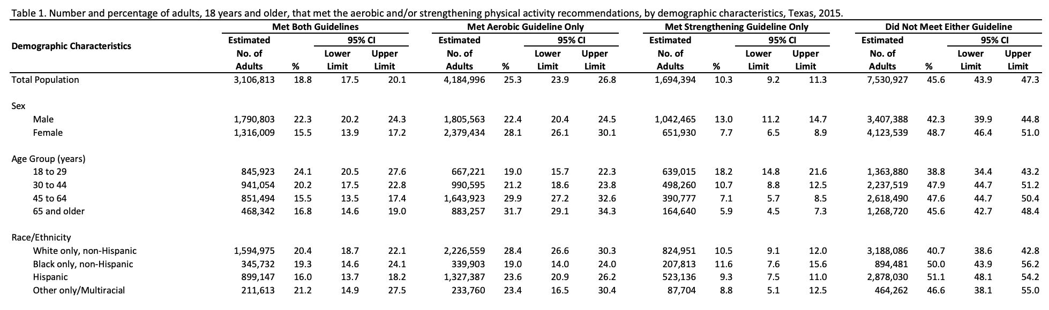
2nd ANNUAL
WEST TEXAS HEALTH DISPARITIES
RESEARCH SYMPOSIUM
Introduction to exercise participation trends in Texas
- Less than 20% of Texans meet both aerobic and resistance training guidelines.
- With age, adherence to these guidelines decreases, though aerobic activity sees relatively better participation.

Slide 5
2nd ANNUAL
WEST TEXAS HEALTH DISPARITIES
RESEARCH SYMPOSIUM
Demographic Challenges in El Paso
- El Paso has seen a significant increase in the population aged 60+ over the last 5 years.
- The city's 82% Hispanic demographic is less likely to meet physical activity guidelines, presenting unique challenges.

Slide 6
2nd ANNUAL
WEST TEXAS HEALTH DISPARITIES
RESEARCH SYMPOSIUM
Critical need of strength training participation in the elderly
Strength training is essential in preventing pathologic changes in bone and skeletal muscle, reducing the risk of frailty and mortality.
- Falls are the leading cause of accidental deaths in the elderly, with the CDC reporting significant hospitalization rates due to this issue.
- Individuals aged 60+ who suffer a nonfatal hip fracture face a 178% increased risk of mortality within a year post-injury.
- Annually, 800,000 older adults are hospitalized because of falls

Slide 7
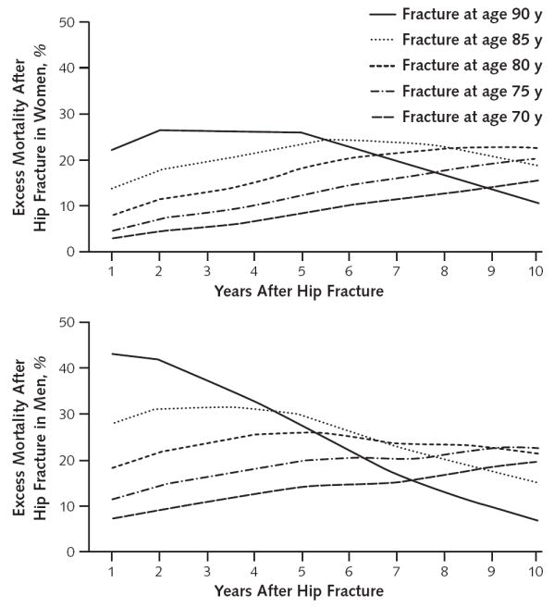
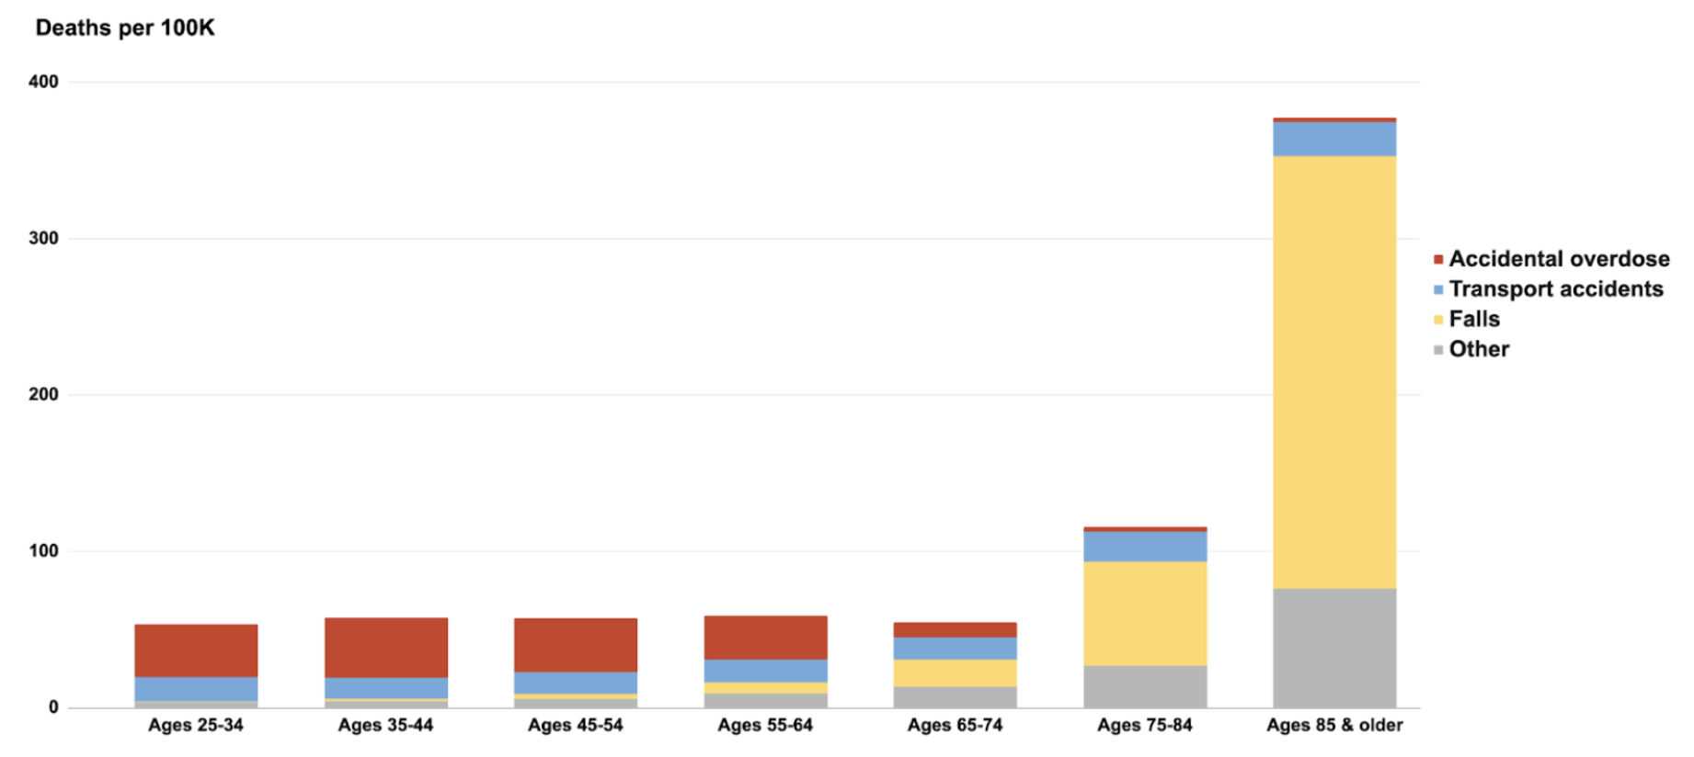
2nd ANNUAL
WEST TEXAS HEALTH DISPARITIES
RESEARCH SYMPOSIUM
Health risk of inadequate exercise
Figure: age-adjusted accidental deaths;
source- CDC 2019
Figure: all cause mortality by age following hip fracture;
source- PMID 20231569
Notes:
Source:
https://www.cdc.gov/nchs/
https://www.ncbi.nlm.nih.gov/pmc/articles/PMC3010729/

Slide 8
2nd ANNUAL
WEST TEXAS HEALTH DISPARITIES
RESEARCH SYMPOSIUM
Overcoming barriers to exercise
US adults and physicians alike recognize the health benefits of exercise, with a majority favoring its promotion.
Public policy, culture, and social factors significantly influence exercise participation.
A significant proportion of healthy adults express fear of injury as a barrier to exercise, suggesting an opportunity for healthcare professionals to address this concern.
Lower injury rates in weight training (0.24 - 1 per 1000 hours) compared to running (2.5-12.5 per 1000 hours) present an opportunity for safe exercise promotion.
Notes:
1. Fear of Injury as a Barrier to Exercise:
- Source: Keogh, J. W. L., & Winwood, P. W. (2017). The Epidemiology of Injuries Across the Weight-Training Sports. Sports Medicine, 47(3), 479–501. [Link](https://link.springer.com/article/10.1007/s40279-016-0575-0)
- This study provides insights into injury rates across various weight-training sports, highlighting the lower risk compared to other activities.
2. Injury Rates in Weight Training vs. Other Sports:
- Source: van Gent, R. N., Siem, D., van Middelkoop, M., van Os, A. G., Bierma-Zeinstra, S. M. A., & Koes, B. W. (2007). Incidence and Determinants of Lower Extremity Running Injuries in Long Distance Runners: A Systematic Review. British Journal of Sports Medicine, 41(8), 469-480. [Link](https://bjsm.bmj.com/content/41/8/469)
- This source compares injury rates in running, providing context for the relative safety of weight training.
3. Addressing Exercise Fears in Healthcare:
- Source: Sallis, R. E. (2009). Exercise is medicine and physicians need to prescribe it! British Journal of Sports Medicine, 43(1), 3-4. [Link](https://bjsm.bmj.com/content/43/1/3)
- Although not directly related to the fear of injury, this article emphasizes the role of healthcare professionals in prescribing exercise as a means to overcome barriers to participation.

Slide 9
2nd ANNUAL
WEST TEXAS HEALTH DISPARITIES
RESEARCH SYMPOSIUM
Empowering clinicians to prescribe exercise
- Primary care physicians are key to reversing the trend of declining strength training participation among the aging population.
- A 2012 meta-analysis highlighted the efficiency of healthcare professional counseling on physical activity, revealing that counseling just 12 individuals can lead to one sustaining an exercise program for a year.
-Compare this to the estimated 50 to 120 individuals needed for smoking cessation advice to have a similar effect.
-This demonstrates the potential for significant impact through targeted exercise counseling, positioning it as a more effective intervention than many other lifestyle changes.
- Clinicians can leverage this opportunity by integrating exercise advice into routine patient interactions, focusing on the low injury rates and high benefits of strength training.
Notes:
Source Citations:
- For effectiveness of physical activity counseling: https://www.bmj.com/content/344/bmj.e1389
- For comparison with smoking cessation counseling: https://pubmed.ncbi.nlm.nih.gov/18425860/

Slide 10
2nd ANNUAL
WEST TEXAS HEALTH DISPARITIES
RESEARCH SYMPOSIUM
Enhancing strength training participation
-Current trends in Texas and demographic changes in El Paso underline the need for weight bearing exercise prescription for all, especially the elderly.
-Addressing barriers and cultural disparities is crucial for enhancing exercise participation
-Clinicians play a vital role
-Beyond immediate barriers, exploring nuanced challenges like integrating exercise promotion into healthcare, overcoming educational gaps in medical training, and improving exercise prescription accuracy are essential.
-Let's commit to raising awareness and educating both clinicians and patients about the life-enhancing benefits of regular strength training!

Slide 11
2nd ANNUAL
WEST TEXAS HEALTH DISPARITIES
RESEARCH SYMPOSIUM
Thank you

