Slide 1

Management of the Pregnant Trauma Patient: Perspectives and Updates
Natalie Hodges MD, MPH PGY5
Ari Halldorsson Trauma Symposium
10/7/23

Slide 2

Disclosures
I have at one point been pregnant
I am an aspiring Trauma Surgeon

Slide 3
Introduction
A pregnant woman is in fact, not just an adult with a weird tumor
Distinct epidemiologic factors from the general population
→Significant morbidity to fetus and to mom
→Prevalence of IPV
Anatomic and physiologic alterations that affect response to trauma
→Physiologic anemia has wide-ranging effects that are accentuated
→Anatomic changes contribute to altered injury presentation
Ramifications of trauma care on normal gestation

Slide 4
Epidemiology
Injury is the most common cause of non-obstetric maternal mortality in the US
Correlated with preterm birth, low birth weight and fetal demise
Even minor trauma can be a significant risk to the fetus
Trauma complicates an estimated 1 in 12 pregnancies
MVCs account for 50% of all traumatic injuries during pregnancy and 82% of trauma-related fetal deaths
1 in 4 women will fall during their pregnancy
Notes:
women requiring evaluation in an ER (even without admission needs) 20% more likely to have a premature or LBW childFalls also common due to joint laxity, weight gain and postural instability
Falls also common due to joint laxity, weight gain and postural instability
Falls are associated with an 8-fold increase in placental abruption, a 4.4-fold increase in preterm labor, a 2.1-fold increase in fetal distress, and a 2.9-fold increase in fetal hypoxia

Slide 5
Anatomy and Physiology
Anemia of pregnancy: Disproportionate increase in plasma volume relative to RBC volume
Uterine compression of the IVC decreases preload
Must rule out traumatic cause for hypotension or tachycardia
Hypovolemia may restrict fetal blood flow
Growing uterus displaces the diaphragm
Left axis deviation secondary to upward pressure on the heart
Increased coagulation factor concentration is protective in childbirth; increases thrombotic risk
Maternal nutrition should be supplemented during an extended NPO period at a rate of 36kcal/kg/day
Notes:
→ Allows mom to lose more blood without clinical symptoms
→Critically important to offload by putting women >12WGA into left lateral decubitus
the normal blood pressure drops by 5 to 15 mm Hg, and the resting heart rate increases by 10 to 15 bpm to increase cardiac output
Shunting of blood away from the placenta may manifest as fetal distress before systemic signs of hemorrhage are seen in the mother
blood flow is entirely dependent on maternal mean arterial pressure
Most pregnant women will have some degree of benign pericardial effusion, while an electrocardiogram will show a slight left axis deviation from the altered position of the heart.¹⁵

Slide 6
Initial Assessment and Management
  Initial assessment should be the same as any trauma patient
  Fetal mortality is directly correlated with maternal injury severity
  Liberal use of supplemental O2-target >95%
  →Small incremental increases in maternal SpO2 have marked changes in fetal SpO2
  Aggressive fluid resuscitation should be used; vasopressors should be avoided if possible
  Ultrasound (eFAST) is an important adjunct
  Measuring fundal height to estimate age-but beware uterine trauma

Slide 7
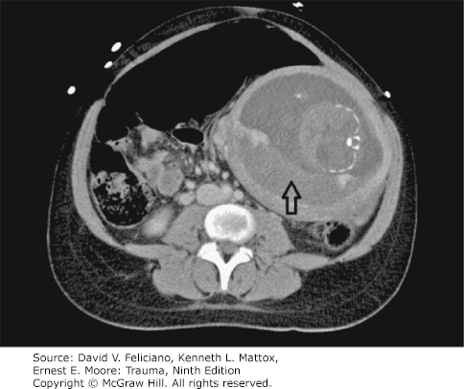
Fetal-Placental Assessment
  Fetal mortality: Primary or Secondary
  Abruption, maternal hypotension, preterm delivery
  Vaginal bleeding, ruptured membranes, bulging perineum, contractions
  Fetomaternal hemorrhage-Kleihauer-Betke test; 300mcg RHOGAM/30mL fetal blood
  At least 6 hours of fetal heart monitoring for EGA >20wk
  Abruption-separation of placenta from myometrium
        → Only 35% of patients bleed
        →Can present up to 24h post injury
        →Early delivery with fetal distress

Slide 8
Specific Injury Management
  Thoracic:
  →Diaphragmatic elevation is approximately 4cm
  Blunt abdominal:
  →Maternal shock associated with 80% fetal mortality
  →Abruption complicates 1-6% of minor injuries; 50% of major
  →Uterine rupture <1%
  Pelvic
  →Maternal pelvic fx late in pregnancy can risk skull or brain injury
  →Fetal mortality rate approaches 35% in pelvic fractures
  →Dilated blood vessels and risks of embolization
  Penetrating
  →Maternal mortality higher than in blunt, but fetal mortality approaches 73%
  →Low threshold for diagnostic laparoscopy; peritoneal response is blunted
  TBI
  →GCS<8 negatively associated with fetal mortality; limit mannitol
  Burns
  →>40% TBSA approaches 100% fetal mortality; consider delivery in 3rd trimester

Slide 9
Special Considerations: Potpurri
  TXA: Pregnancy Class B medication, not excluded from CRASH-2, no increase in thrombotic complications in prior studies
  Cesarean Delivery should be considered within 4 minutes of cardiovascular collapse
  →Can be helpful to both ROSC in mom and fetal support

Slide 10
Special Considerations: IPV
  Most common form of intentional trauma in pregnancy
  Reported rates of 3.2-28%; Likely higher
  Risk factors: substance abuse, low SES, unintended pregnancy, history of witnessed violence
  54.3% of pregnancy-associated suicides and 45.3% of homicides directly attributable to IPV
  Doubles risk of preterm birth and low birth weight
  Half of mothers subjected to IPV in pregnancy develop postpartum depression
  Increased homicide risk for 24 months post delivery
  Given fleeting contact and underreported nature, broadly screen pregnant trauma patients

Slide 11
Questions?

Slide 12

