Slide 1
Global Food Security: How to Feed the Hungry
Clyde Martin
Former Jefferson Science Fellow
United States Department of State

Slide 2
Who am I anyway??
Trained as a mathematician. (Kansas State Teachers College and the University of Wyoming)
Worked at NASA as an aeronautical engineer.
Worked at Utah State as an irrigation engineer.
Worked with the medical school as a statistician.
Now I work on international development and lots of other things.

Slide 3
How did I end up at the DoS??
Came to TTU in 1983 and have been here except for time in Japan and Sweden.
Have written 400+ papers and have directed more than 120 graduate students.
I was bored and needed a break from the University and what I was doing.
Got a phone call saying I was accepted.
Clearance went through in record time.

Slide 4
Arrived at State
Two days of learning the security rules and swearing in.
A week of learning what various parts of the organization did and meeting and getting to know the other fellows.
I was given a list of 16 bureaus at State that did various things and I interviewed with 7 of them.
I was selected by and I selected the head office of the Feed the Future program.

Slide 5
What is Feed the Future?
Part of the more general food security program.
A pointed effort to make some of the developing nations food independent.
Consists of 17 developing nations. Three in the Americas, four in Asia and the rest in sub Saharan Africa (the Sahel). I primarily worked on the African nations.
Bangladesh, Cambodia, Ethiopia, Ghana, Guatemala, Haiti, Honduras, Kenya, Liberia, Malawi, Mali, Mozambique, Nepal, Rwanda, Senegal, Tanzania, Tajikistan, Uganda, Zambia

Slide 6
Not just a US program but is a G8 program.
Every nation in the G8 is making a major contribution (except Russia).
Funding is set at 15 billion dollars.
Each government in the G8 has selected a set of the 17 countries to concentrate their efforts.
The goal of the program is to make each country food sufficient and by doing so reduce hunger and eliminate famine.

Slide 7
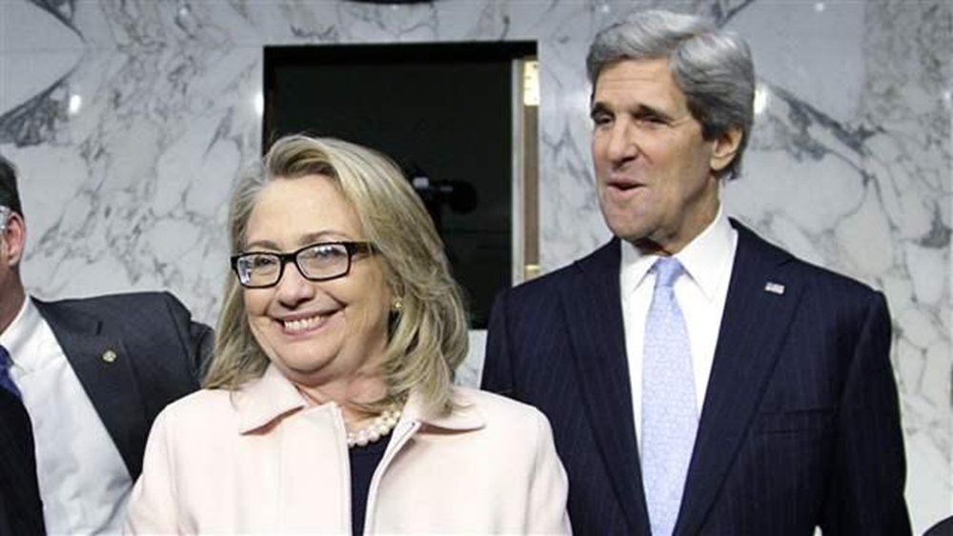
Who are the leaders in the US?
I worked for two secretaries.

Slide 8
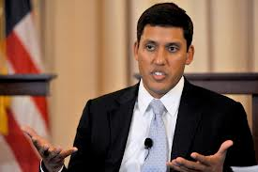
Director of USAID
Rajiv Shaw came to USAID from the Bill and Melinda Gates Foundation.

Slide 9
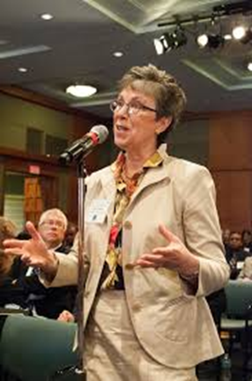
Under Secretary Woteki, USDA
Secretary Woteki is the director of the Feed the Future effort at USDA.

Slide 10
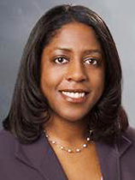
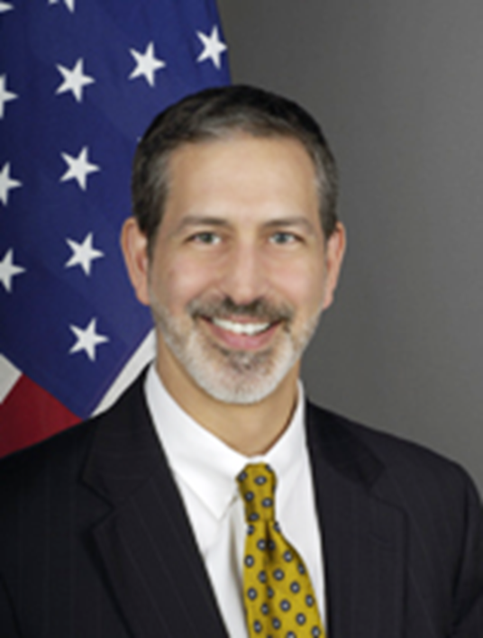
The two go to people.
Tjada D'Oyen McKenna, USAID
Jonathan Shrier, DoS

Slide 11
What are the farms like in Africa?
Small is the key word.
Two to twenty acres with the average being closer to 2.
Poor soil.
Infrequent rain with droughts common.
Poorly producing crops.
No machinery.
No fertilizer.

Slide 12
What do the farmers do?
Men go to the cities to try to find work.
Women and children stay in the village.
Try to produce enough food to sustain themselves.
Men come back to the village with HIV/AIDS.
Wife becomes infected children are left with grandparents.
Children don’t go to school and are malnourished.

Slide 13
What has been the traditional response?
When there is a famine provide food aid.
Give money to the governments for establishing health clinics.
Give money to the governments to provide education.
What happens to the money?
The traditional responses didn’t help and in some cases made things worse.

Slide 14
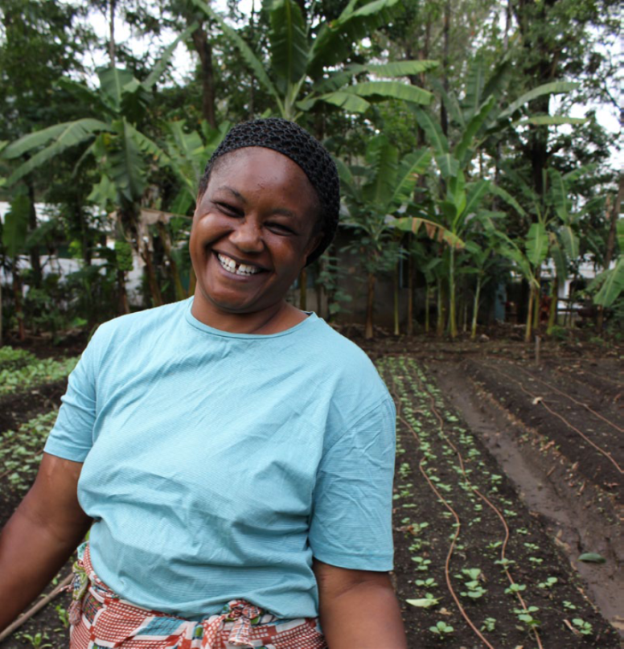
Empower the women!
Women do most of the farming so work with the women!

Slide 15
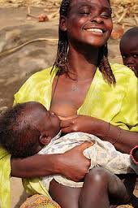
Encourage breast feeding
Malnutrition in the very young is a huge problem. The 1000 Days project is directly aimed at nutrition from conception to three years.

Slide 16
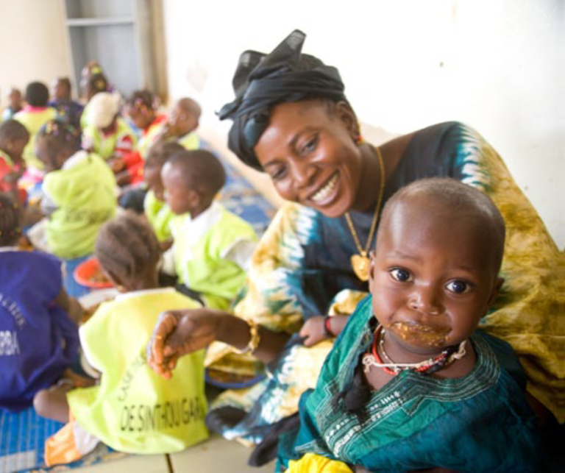
Feed the children!
Make nutritious food available to the children. This should be food produced in Africa by Africans.

Slide 17
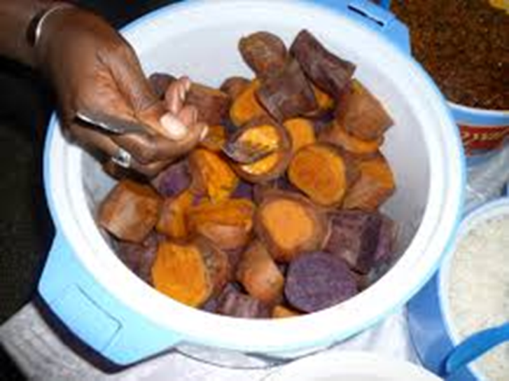
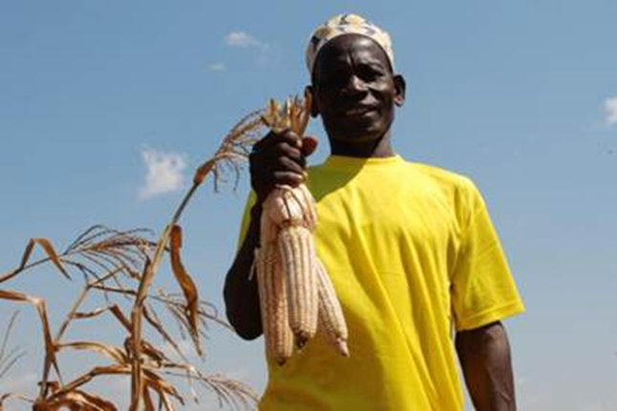
Better crops!
Make available varieties of corn, peanuts, cassava, sweet potatoes, bananas etc. that are engineered for the area and are higher in nutrients.

Slide 18
Better crops
Potatoes in Tajikistan

Slide 19
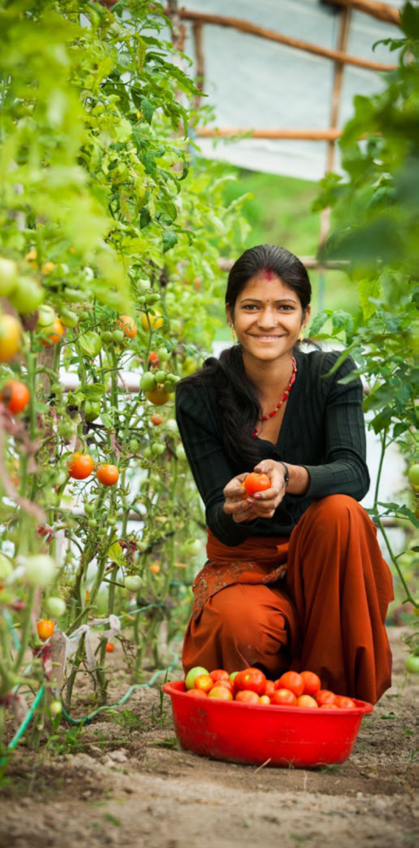
Tomatoes in Bangladesh

Slide 20
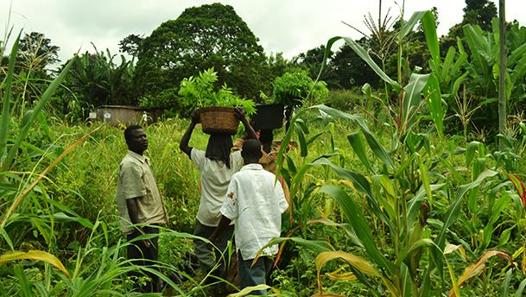
A mixed field in Africa
Note that corn and other crops are mixed. It appears to be squash and a legume.

Slide 21
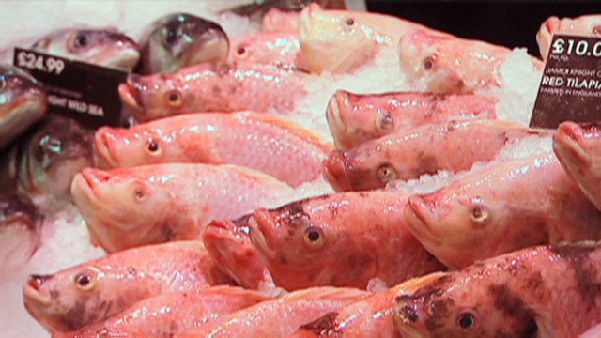
Aquaculture is important in Asia
We are working to bring it to Africa. Qatar is planning a major facility in Qatar.

Slide 22
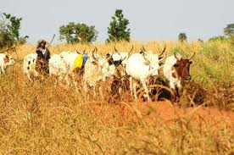
Herding is important in many areas.
The main effort has been to teach management.

Slide 23
How well is it working?
For the last 5 years it has been doing very well.
However there have not been major droughts.
Feed the future has concentrated on the rural areas and has had very little to do with the urban areas.
This is a serious short coming of the program.
The urban areas present a very challenging set of problems.

Slide 24
What did I do?
I became the State Department’s expert on crop insurance for small holders in Africa.
I worked to get weather indexed insurance extended to cover loss from disease and insects.
I worked with a group to determine what the effect of climate change would be on the farmers in the Sahel.

Slide 25
What did I think of the people at DoS and USAID?
I have never worked with a group of people that were as dedicated as the people I saw.
Long intense days with high expectations.
It was a mix of foreign service and regular government employees.
They work under intense pressure.

Slide 26
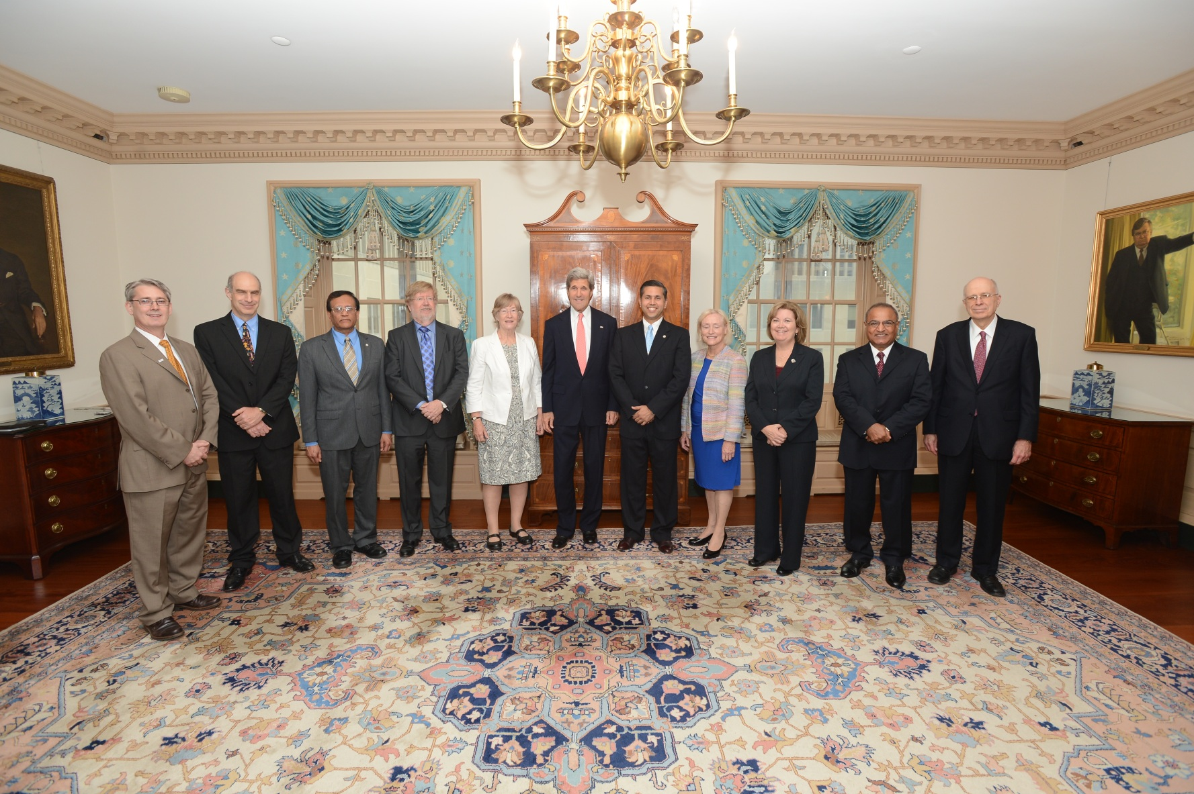
Proof that I was there!!!

