Slide 1
BUSH ALASKA
Third World of the U.S.

Slide 2
Locum Tenens
Definition
Hospitalist/General Pediatrician
Eagle Pass, TX/Portland, OR/Bethel, AK
Prescreened to work in Alaska

Slide 3
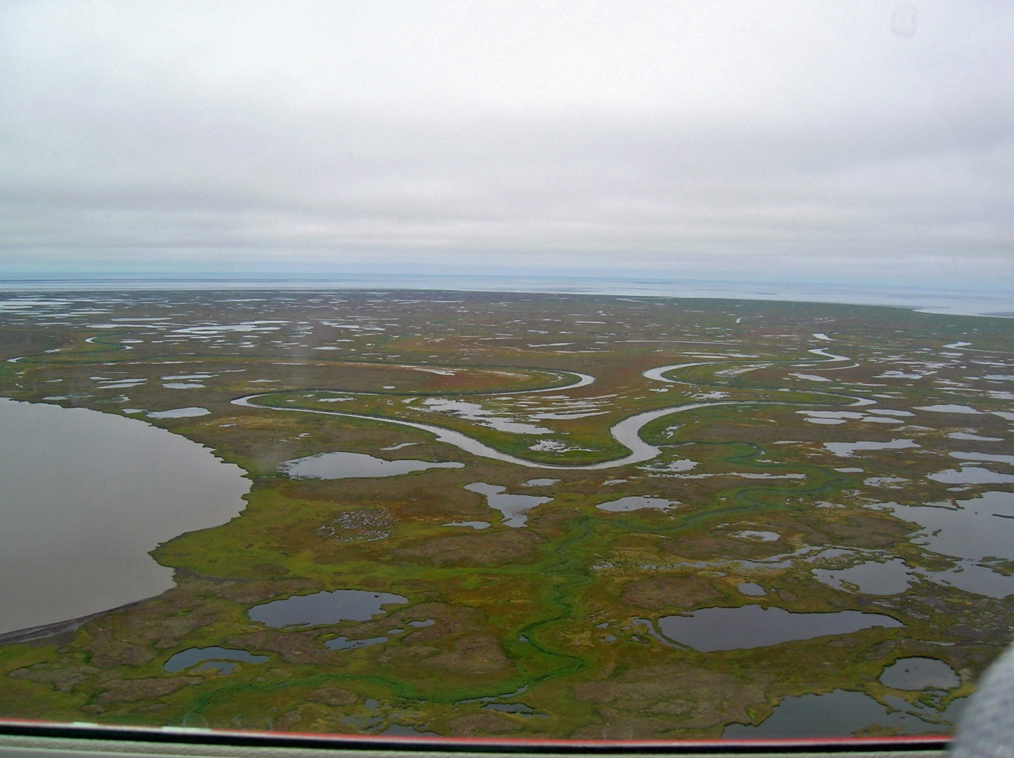
Yukon Kuskokwim Delta-Alaska

Slide 4
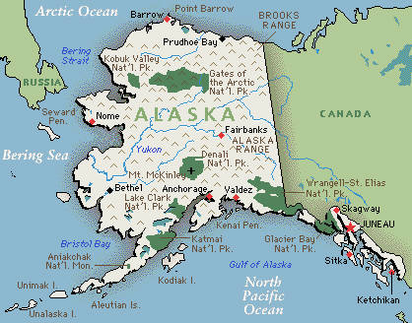
Bethel, Alaska

Slide 5
Bethel, Alaska
Google- “armpit of Alaska”
850 miles west of Anchorage
Population- 6500 (70% Native American-Yu’pik, Chu’pik and Athabascan)
Six miles of roads- transportation in/out by barge(summer only) or plane
Taxi capital of North America
Permafrost/tundra
Milk-$6, Orange Juice-$15
Airport-signs are in Yu’pik

Slide 6
Yukon-Kuskokwim Health Corporation
Indian Health Service
One hospital/main clinic/satellite clinics
Service area-size of state of Oregon/56 villages/40,000 people
Health Aides
Medical students/Residents(FP)
Medivac/bush plane
Clinic appts-boat or airplane

Slide 7
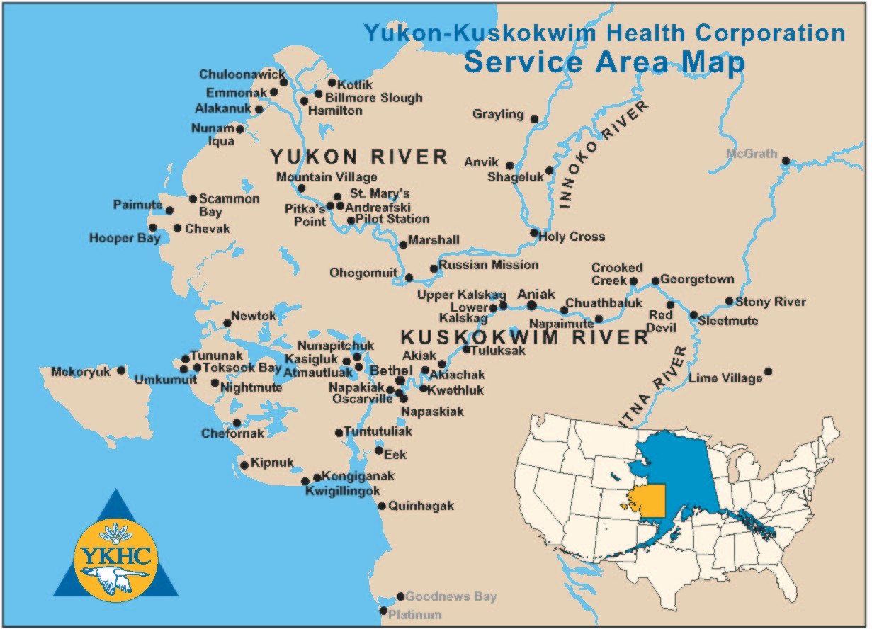

Slide 8
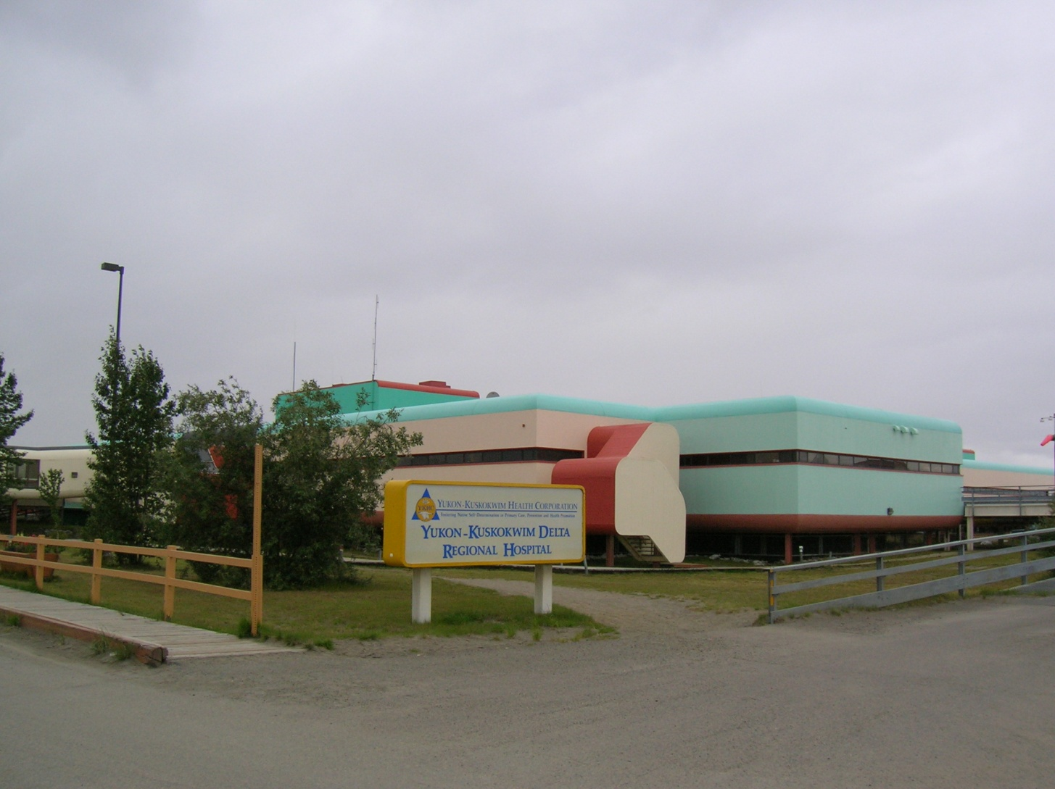
YKHC Hospital-50 beds

Slide 9
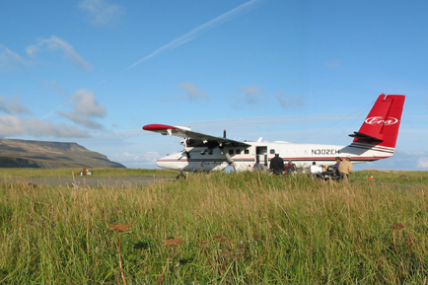
Clinic Appointment Transport

Slide 10
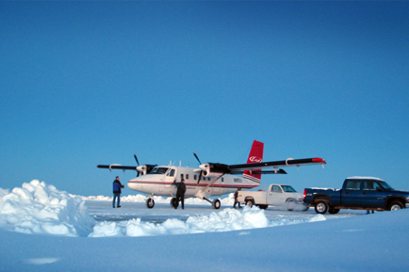
Mekoryuk Air Strip-Medivac

Slide 11
Pediatrics-YKHC
Pediatric Clinic
Hospital Service
On Call
Medivac

Slide 12
Local Terms
Iqmik
Aalsma
Subsistence living
Fish camp
Tribal law
Honey bucket
Dried beaver testicles

Slide 13
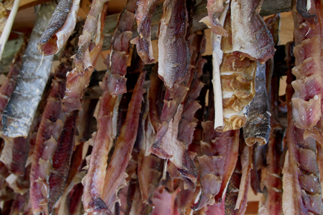
Subsistence Living

Slide 14
Patient Population
Yu’pik/Chu’pik/Athabascan
Mothers have 12-14 children-keep 6
Breastfeeding uncommon-high Vit D deficiency
Level of education
Intermarriage common
Immunocompromised

Slide 15
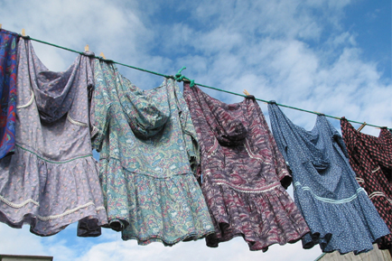
Traditional Dress-Quaspegs

Slide 16
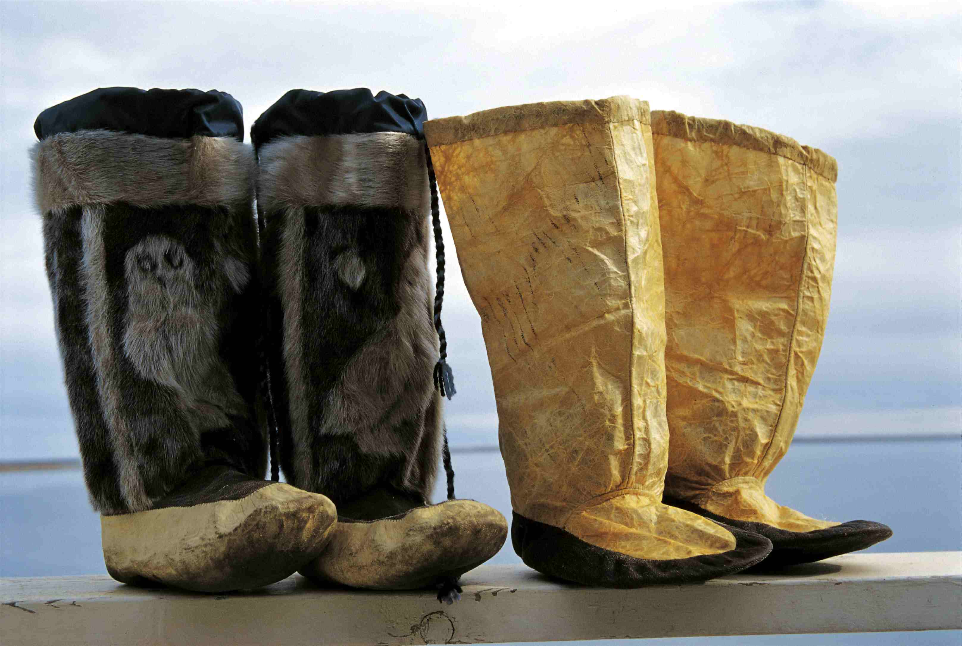
Mukluks

Slide 17
Common Medical Problems
Endemic TB
Adrenogenital Syndrome
Community Acquired MRSA
HIV
Pneumonia(7x in first 12 mos life)
Bronchiectasis
Otitis Media with Perforation
Botulism

Slide 18
Cases
32 week premature infant-phone resuscitation/4wheeler and plane transport
Coding a 2 month old over the phone
Seizure disorder-out of medication
Child abuse-physical/sexual

Slide 19
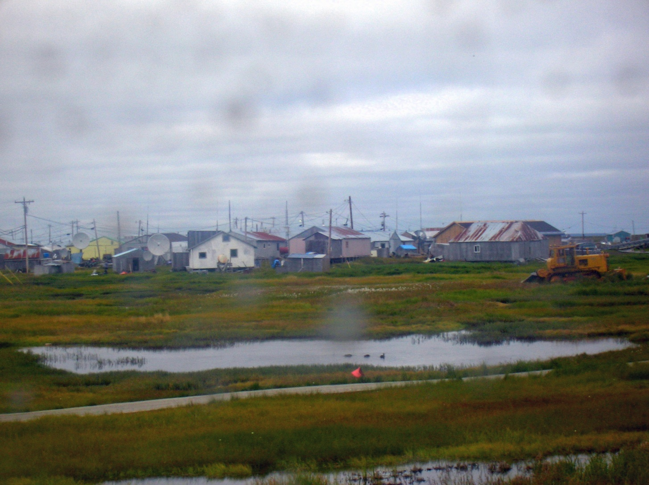
Kipnuk, Alaska

Slide 20
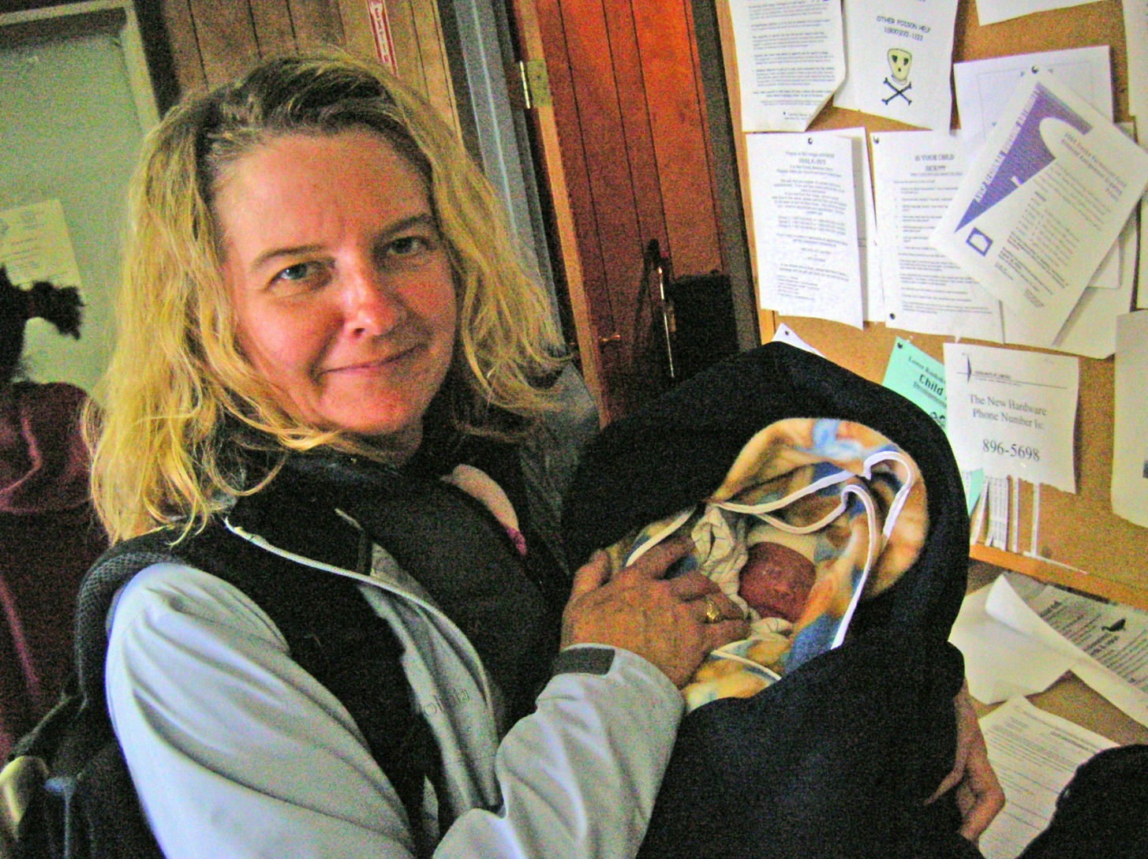
Kipnuk-Preemie Medivac

Slide 21
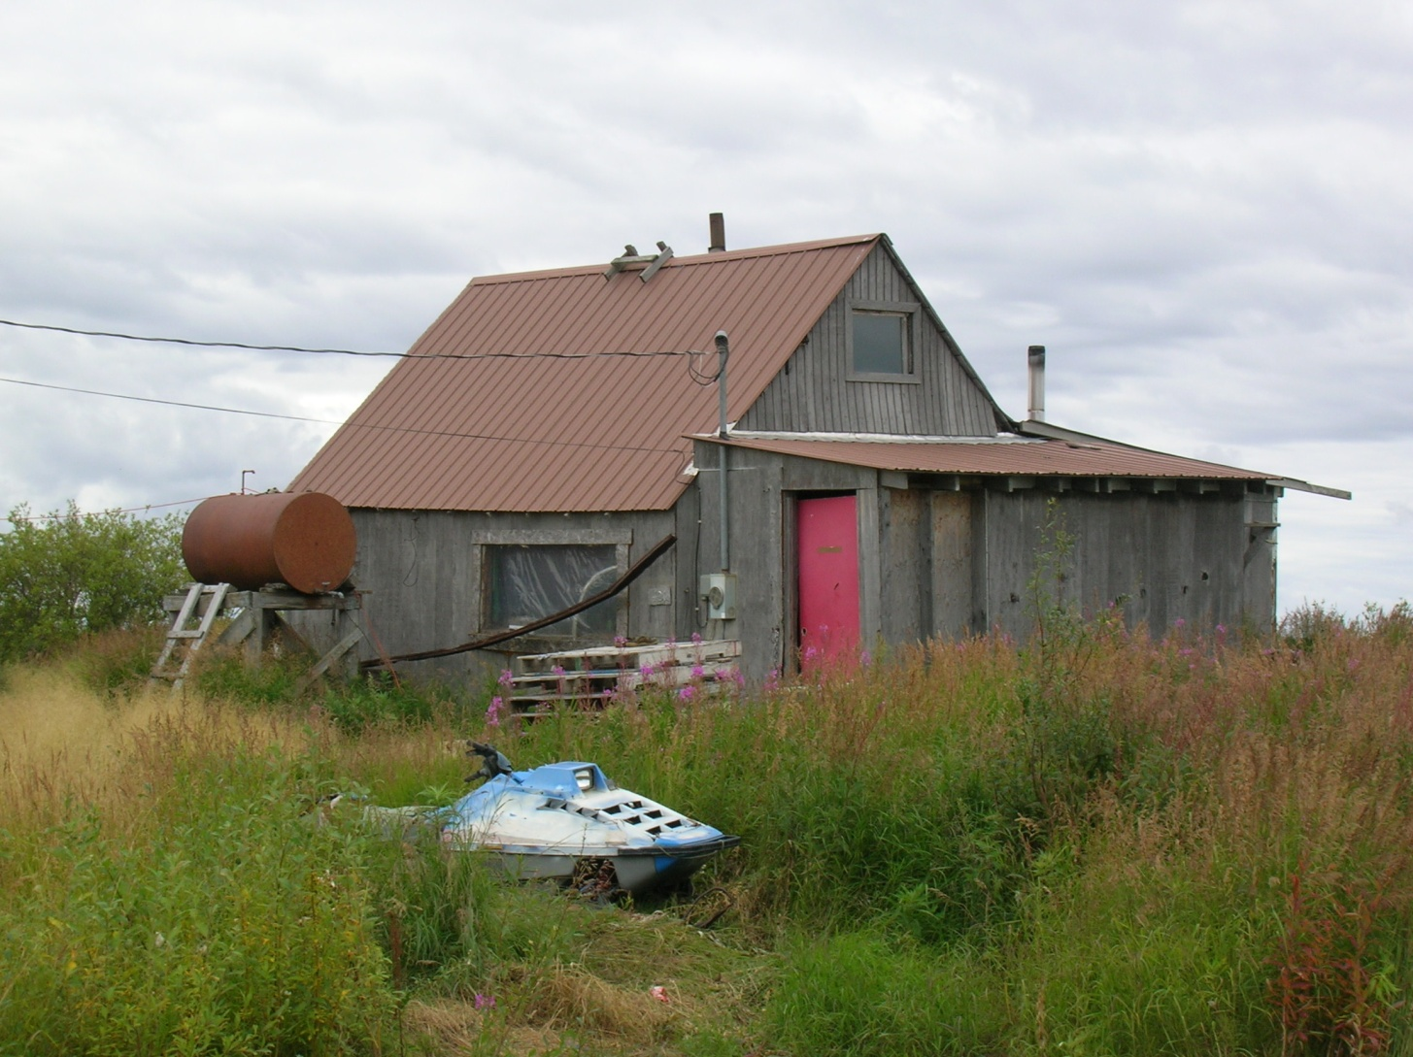
Typical Housing-Bethel

Slide 22
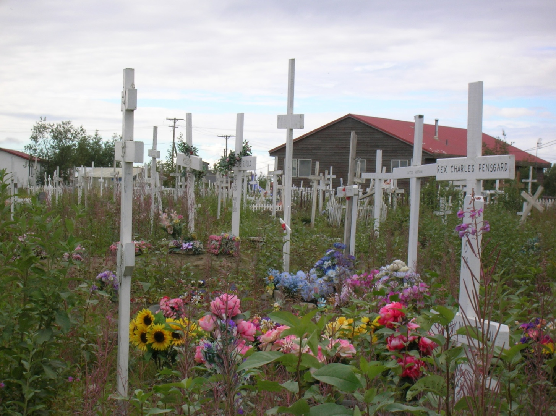
Bethel Cemetery

Slide 23
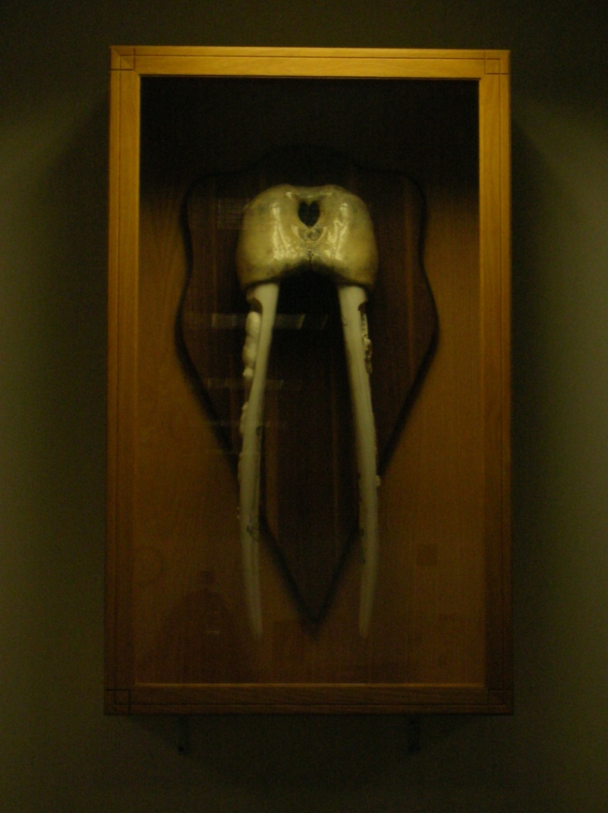
Walrus tusks

Slide 24
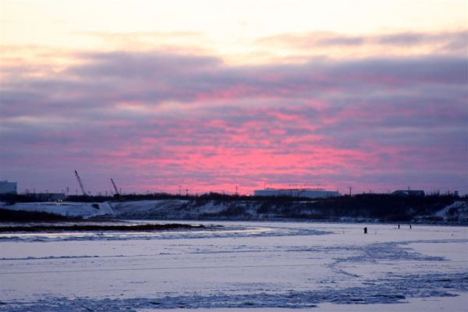
Questions

